Slide 1
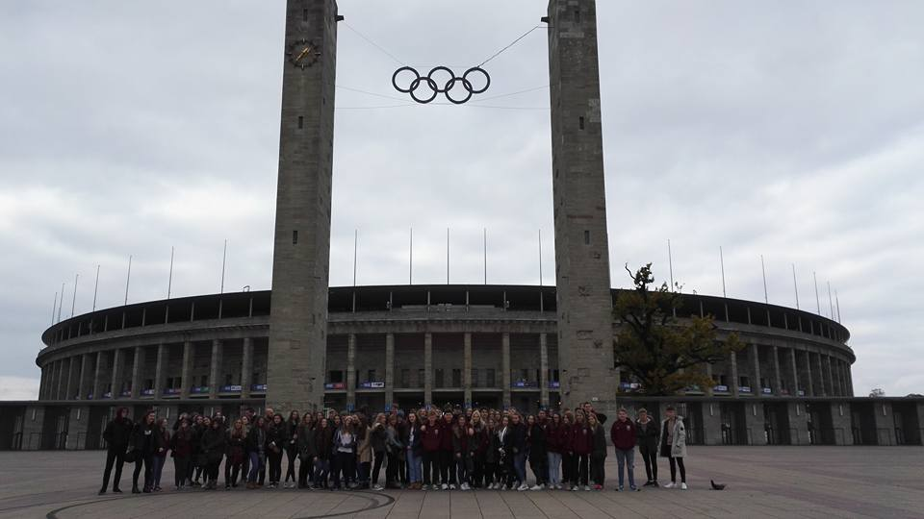
Berlin and Krakow Trip 2016
Priory City and Priory LSST

Slide 2
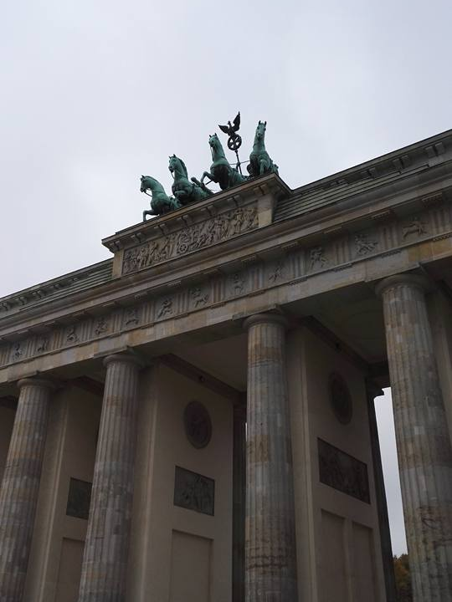
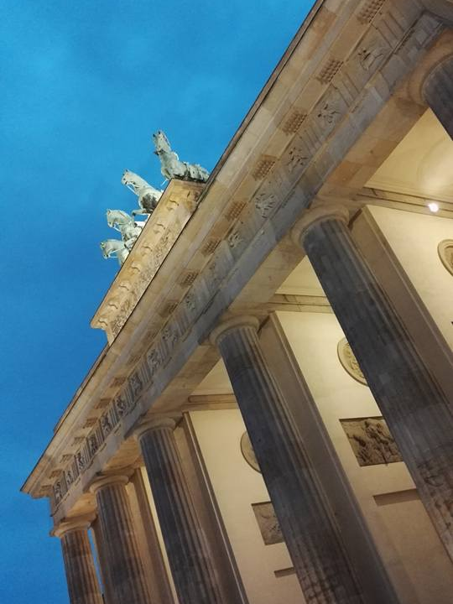
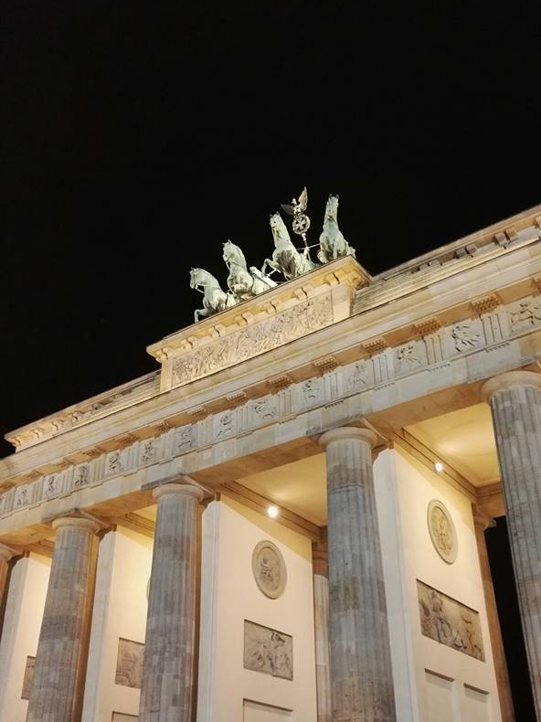
The Brandenburg gate was built in 1791, it’s architecture was inspired by the Acropolis located in Greece. King Wilhelm II intended for it to be a symbol of peace. It is 28m tall and 65.5m wide.
The statue on the top is a quadriga being pulled by 4 horses. It’s driver is Victoria – roman goddess of victory. The quadriga was originally pointing west but, Napoleon stole it when he invaded. When the statue was returned back to Berlin, It was set facing east, to look over Berlin as a sign of victory, as apposed to it’s original sign of peace.

Slide 3
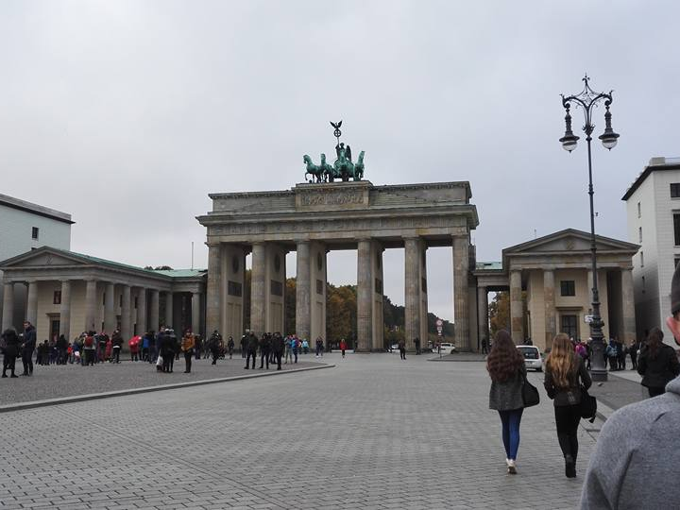

Slide 4
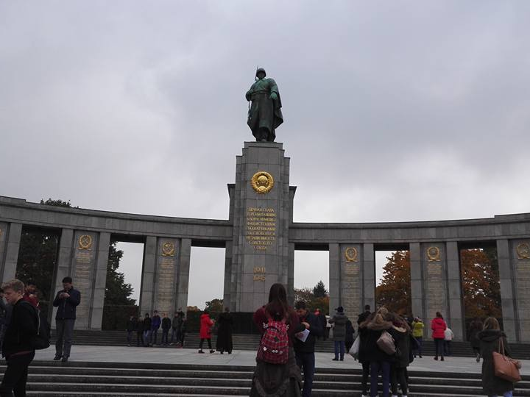
This memorial is for the soviet soldiers who lost their lives while capturing Berlin. The statue represents their power over the German forces and how they will never be superior to soviets. It was positioned in West Berlin deliberately to remind the allies of their loss of 20,000,000 in the entire war.

Slide 5
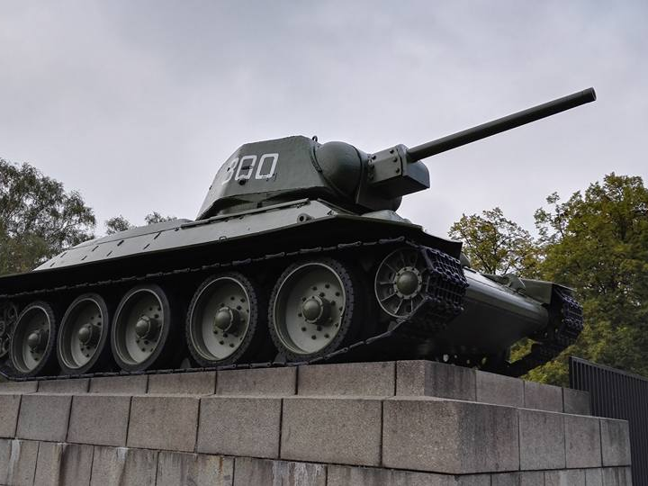
2 of these tans were parked outside the soviet memorial.

Slide 6
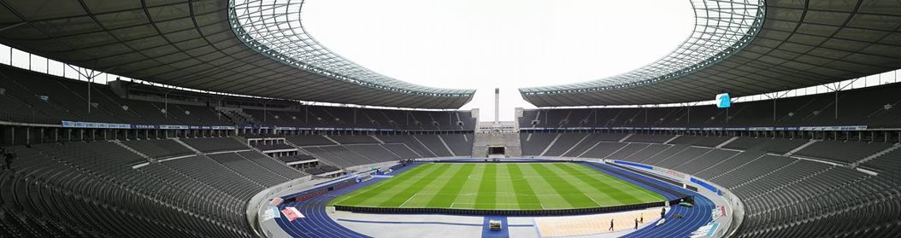
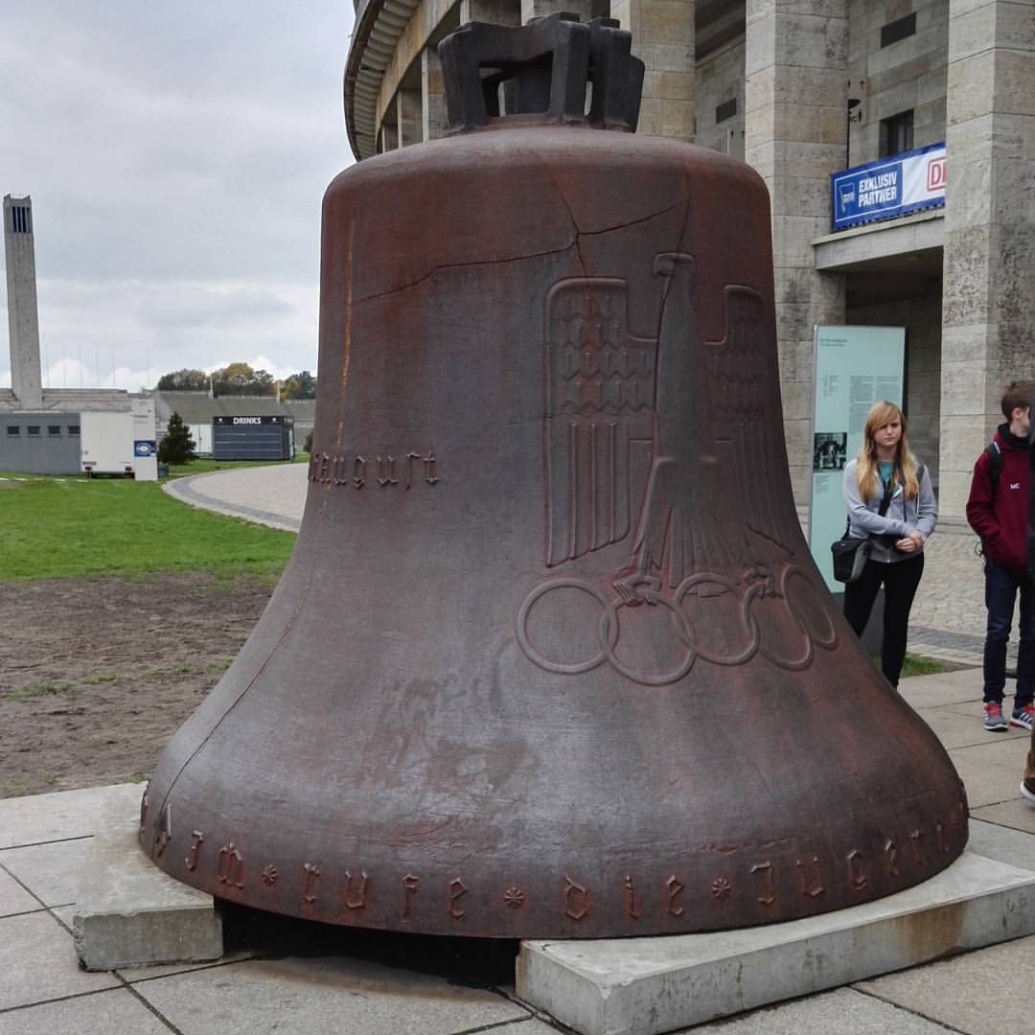
1936 Berlin Olympic a.k.a. Games of the XI Olympiad. 49 nations participated with 3963 athletes in 129 events in 19 different sports. The stadium took 2 years to construct, the field size is 105m x 68m and the capacity of the stadium there is 74,475 seats.
The bell tower (seen at the left of bell picture) was blown up by the Russians when Berlin was invaded in WWII. The bell itself was hit by the Russian tank shell and has a hole in it. Also it is one of the only objects left in Germany that still has a Swastika on it.

Slide 7
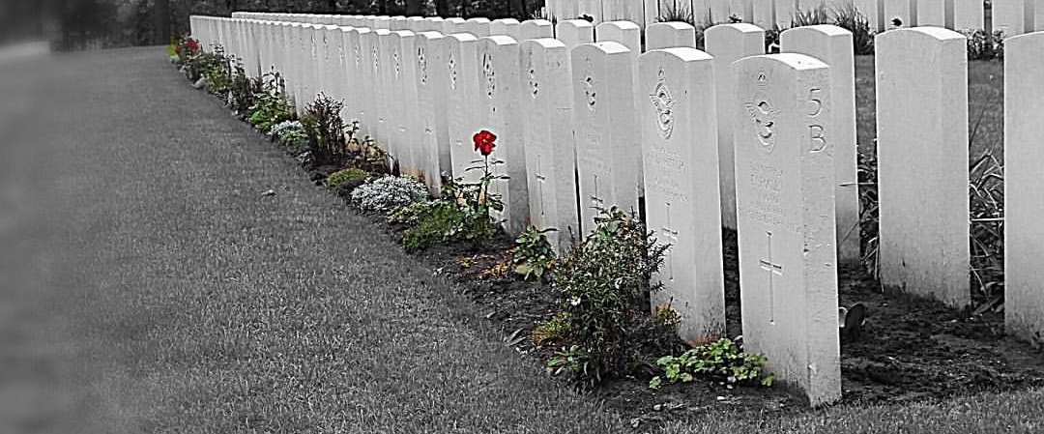
This was a graveyard memorial for the commonwealth. Here, there was lots of graves for bomber crews, including Lancaster Bomber crews who were often from Lincoln and surrounding towns/cities. Each row of graves was one crew. There was lots of different nationalities, ages and religious differences here!

Slide 8
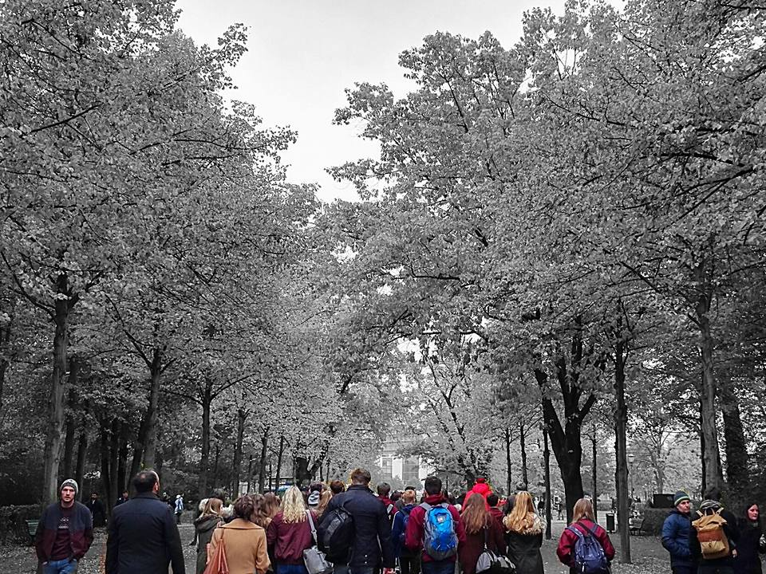
Exploring the beauty of Berlin walks.

Slide 9
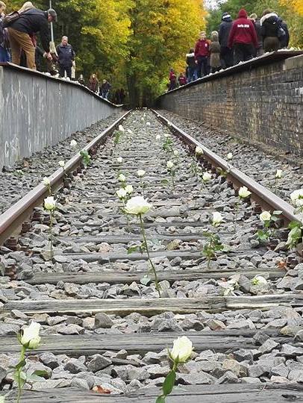
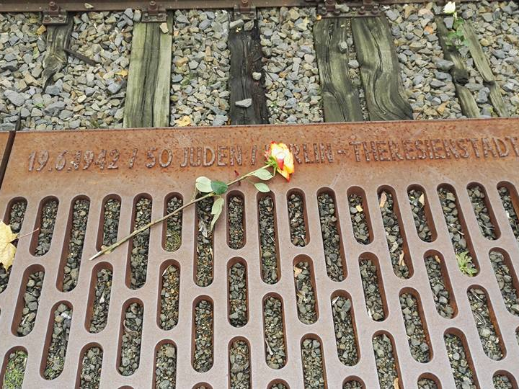
This is Platform 17, the location where lots of Jews from the local area were carted off like cattle to their destination at the various camps. As you can see there is roses everywhere in remembrance of the millions who were brought here. Surrounding the track, on the edges, inscribed was the camp names, the dates, and the amount of Jews taken to said camp on that particular date.

Slide 10
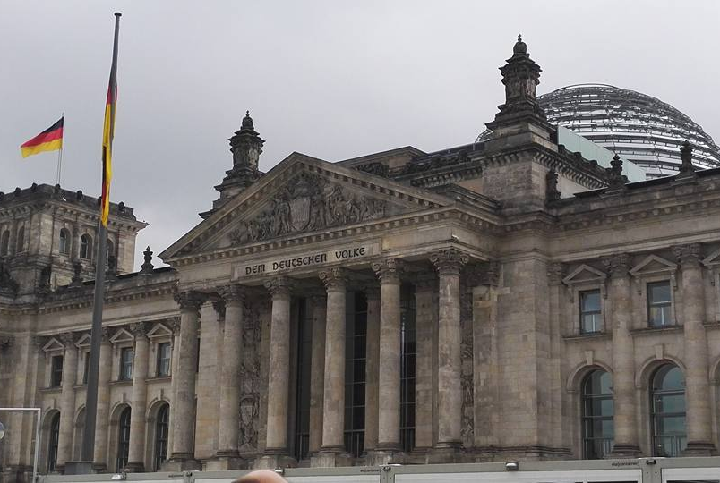
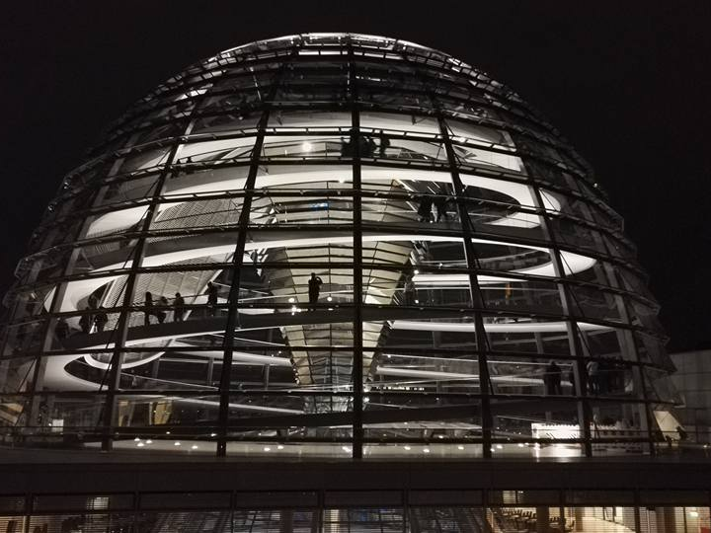
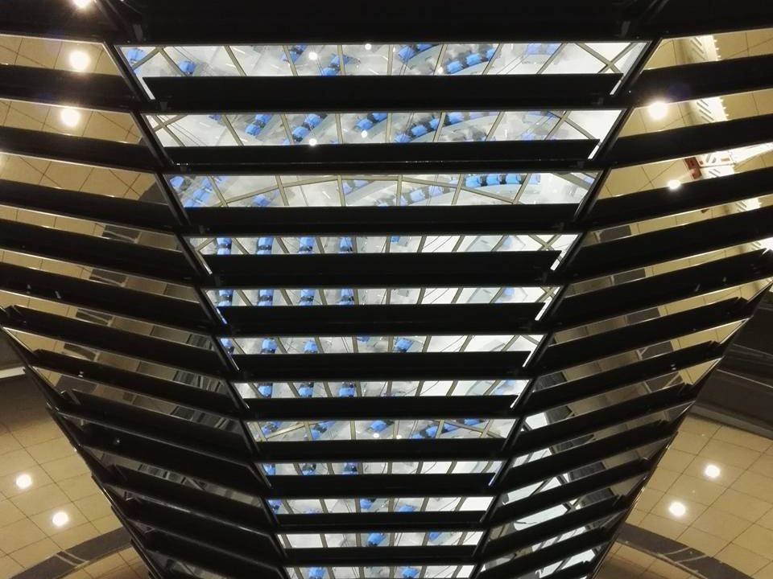
This is the Reichstag building (like our Houses of Parliament). It has an audio tour dome on the top which gives a 360 degree view of Berlin. The dome (bottom left) is open topped with a funnel (bottom right) which collects water which heats the building.

Slide 11
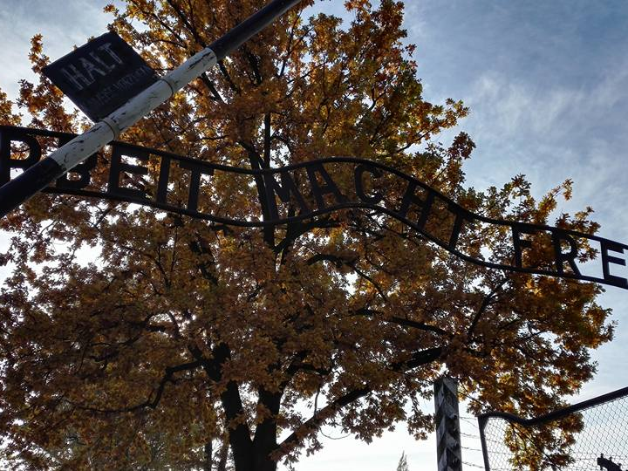
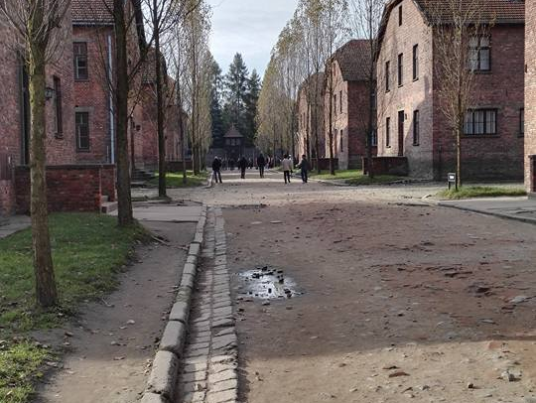
Auschwitz-Birkenau – Built originally as a workers camp containing one gas chamber to get rid of weak/ill workers. It later evolved into a death camp. Total deaths on this camp were between 2,100,000 and 2,500,000 deaths of Jews and other prisoners. The gate sign (left) read ‘work will set you free’ which wasn’t true as the Nazi’s worked their victims to death. The camp itself was considered a 5 star hotel compared to the other death camps because it was built to be permanent as it was for workers, the buildings were made from brick and had proper living conditions compared to the other camps where there was just 4 wooden walls and a roof, not even a proper floor. The other camps were built specifically to terminate an entire group of people and then to be demolished afterwards.

Slide 12
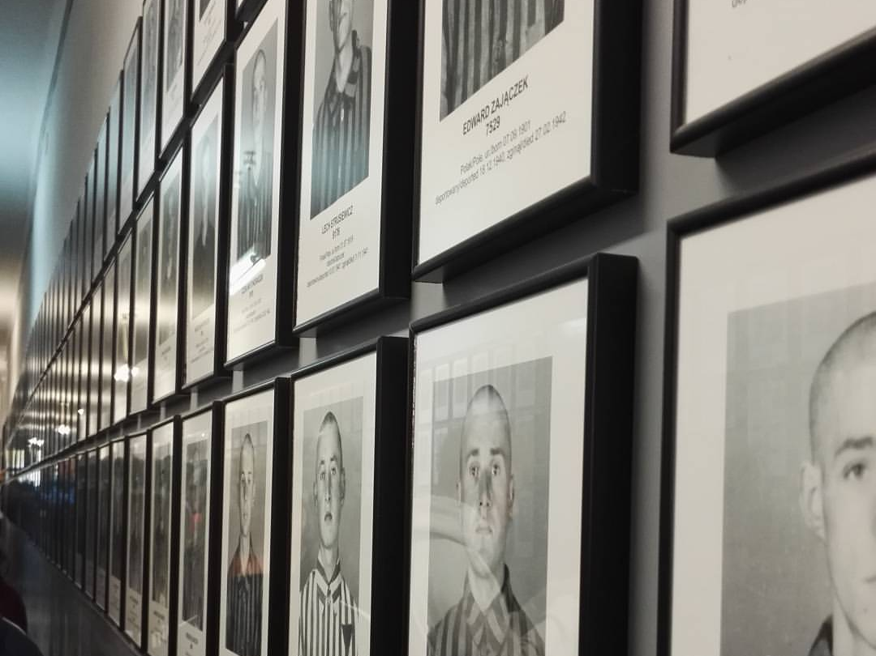
The walls of the blocks were lined with pictures of the Jews and prisoner who once lived and worked here.

Slide 13
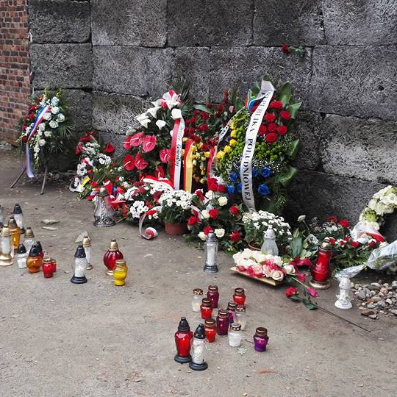
This is the ‘death wall’ located on Auschwitz-Birkenau where prisoners were executed at point-blank range in punishment. The punishment was usually for missing/escapee prisoners, the Nazis didn’t care if their workers died, they only cared about the amount of bodies. If someone died while working, their body was to be brought back to be counted as dead. If a body was missing, the prisoner was presumed as an escapee. 10 workers would be picked at random to be executed.

Slide 14
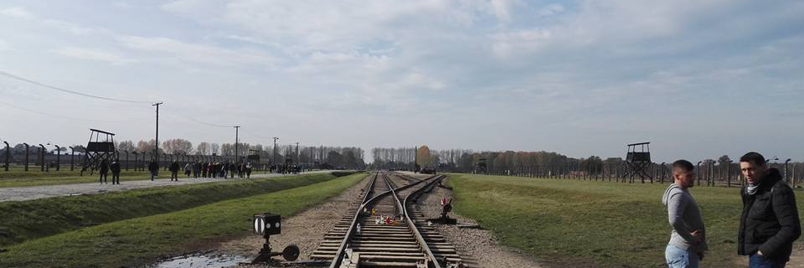
This is the main Auschwitz camp, it was purposely built to kill Jews and other communities. Half of the huts located on the camp had been destroyed when the Soviets approached the location but there was still plenty for us to see. There was 5 gas chambers in total located on this camp, however hey were also destroyed before the Soviets arrived there to get rid of evidence of crime. The visit to this camp was really emotional to take into perspective how many people were murdered and the conditions they lived in and experienced in their final hours, days and sometimes months if the prisoners were fortunate.

Slide 15
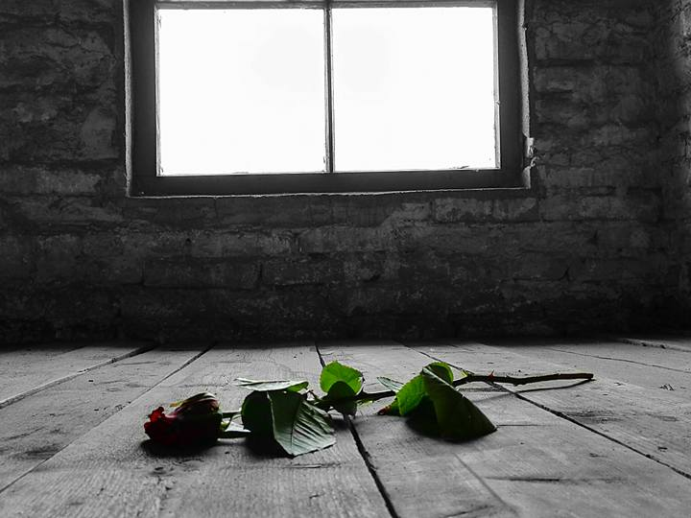
This rose was laid on a bunk of a hut where children were housed. 250,000 children were subjected to the horrors of camps, but only 7,000 lived to tell their story.

Slide 16
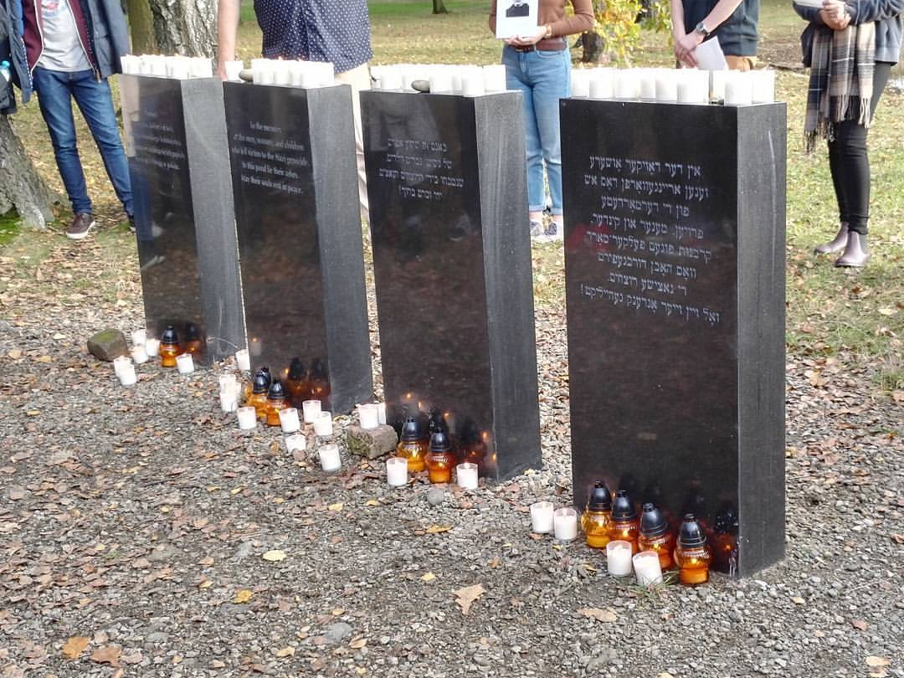
This is a memorial dedicated to the Jews who’s ashes were dumped into the ponds like trash, this is so the missing people will never be forgotten. Every student attending the trip placed a white candle upon these grave stones.

Slide 17
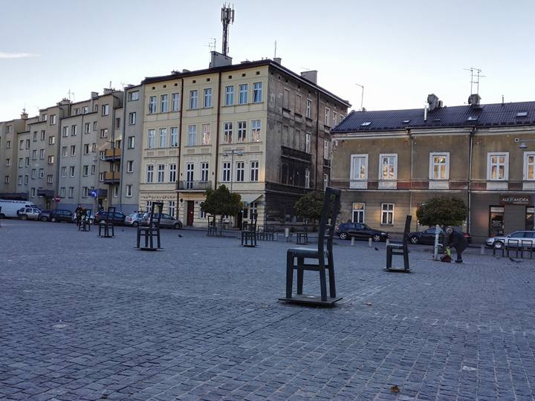
This square was located at the center of a ghetto where Jews were temporarily housed. The chairs represent the people who went made to stand/sit for hours upon end in whatever condition. It would have been torturous. The small chairs lining the edge of the square represented the children who were killed during the Holocaust. In the ally (middle of photo at the back) all the children from the orphanage were shot at point-blank range because they were no use to the Nazis regime, the bullet holes can still be seen today.

Slide 18
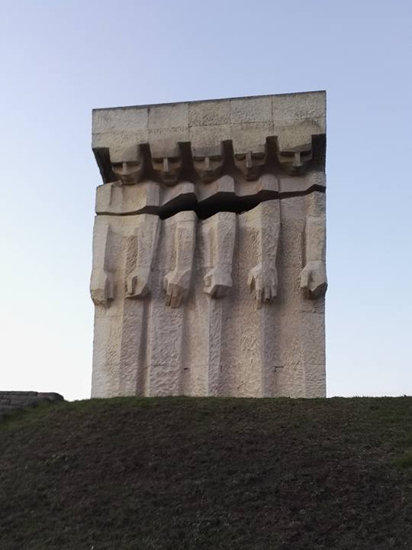
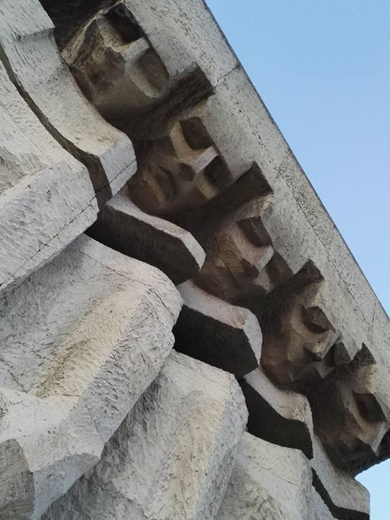
This memorial is to the Jews who were killed at the camp featured in Schindler’s list. This statue represents the Soviets looking down at the dead in grief and anger over the horrors of the Holocaust. Inscribed on the back of the statue is writing, it specifically names ‘Hitler’ to blame the deaths entirely on him.

Slide 19
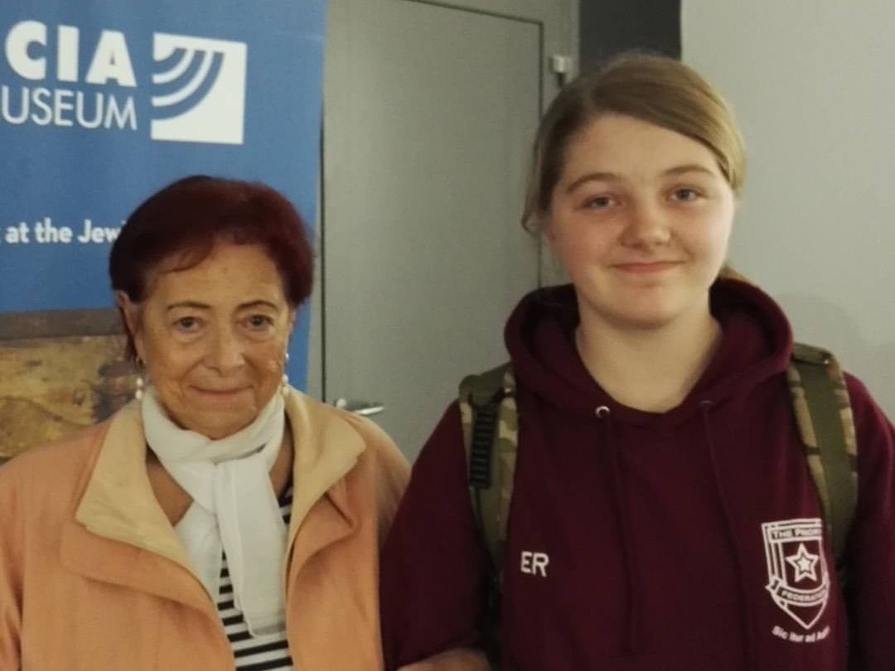
This is Rena Rach who is a survivor of the Holocaust. She was fortunate to be helped out of a ghetto so she didn’t have to be killed in a camp because she was only a baby. She was born in the ghetto she escaped.

Slide 20
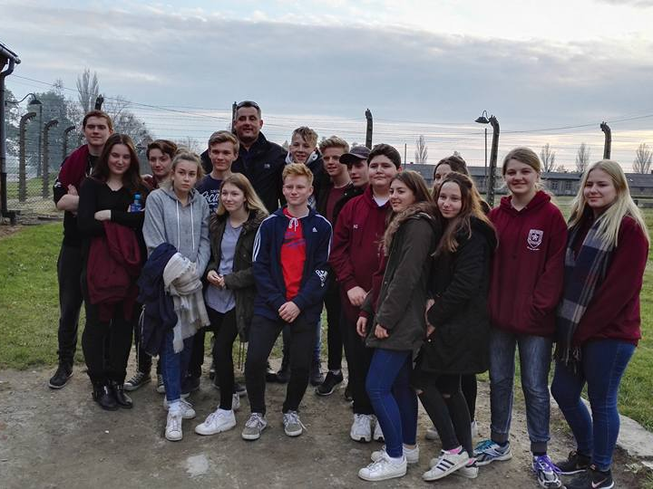
Special thanks to Richard, out tour guide, for teaching us so much about Germany and the Holocaust. It was an amazing trip!

