Slide 1
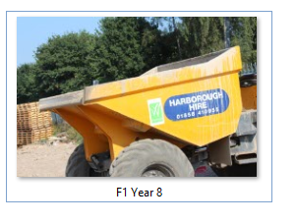
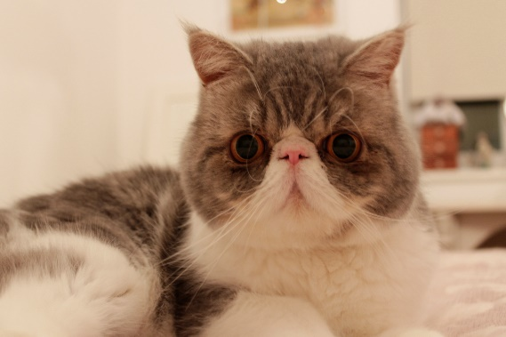
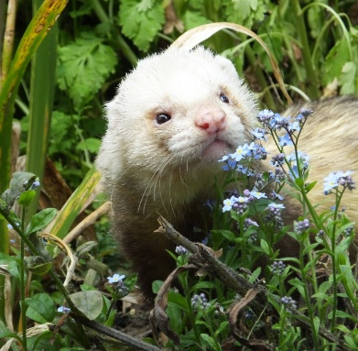
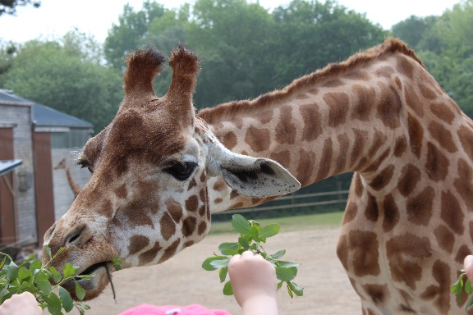

THE ART DEPARTMENT
Invites you to take part in our
HOUSE PHOTOGRAPHY COMPETITION
Entry is open to ALL staff and students. A maximum of 10 photographs can be entered.
’Animals’
Contact sspencer@prioryacademies.co.uk Miss Spencer to receive a link, so you can upload your entries on to SharePoint.
Rules: You must title your photograph with your tutor group and year when you save your photograph.
Only enter photographs you have taken yourself . Entries must be made by Thu 30th March 2017.
Inspiration: Pets Wildlife Zoos
Reward = 10 Vivo’s. Keep an eye on The Art Department SharePoint page for the latest entries!

