Slide 1
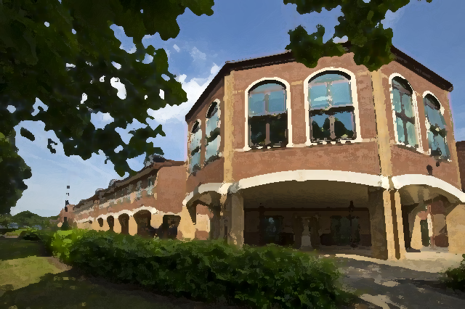
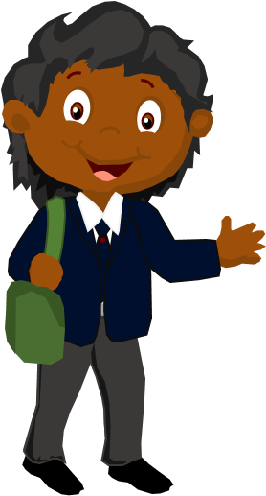
Hi, I’m Lynk.
With some help from my friends I’m going to show you around The Priory Lincoln Academy.
Click on each information icon to find out more!
Please press your ‘Enter’ key to begin your tour.

Slide 2
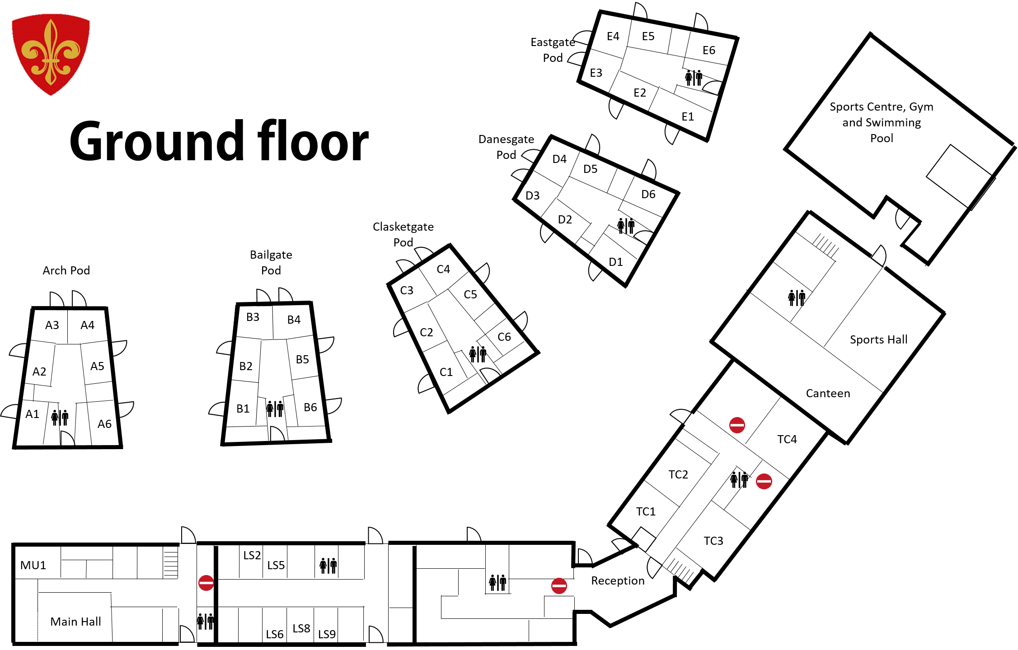



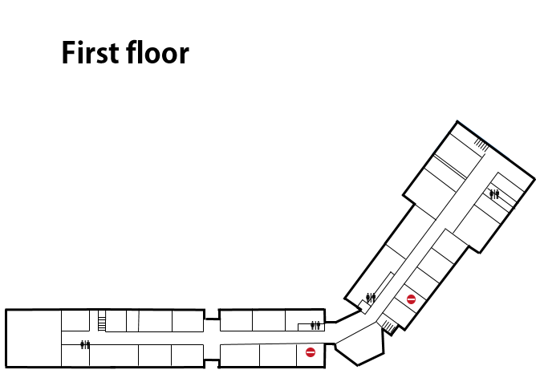
The Reset Room
The school shop is open 8-8.30am break & lunch.
Mrs Hymers sells lots of stationery products such as pens, pencils, rulers and highlighters. Prices range from 5p for a pen or pencil up to 45p for a branded pen.
This is student reception. If you are late to school you need to see Mrs Jones and sign in here.
Mr Trow’s office
To return to the map click on the link.

Slide 3

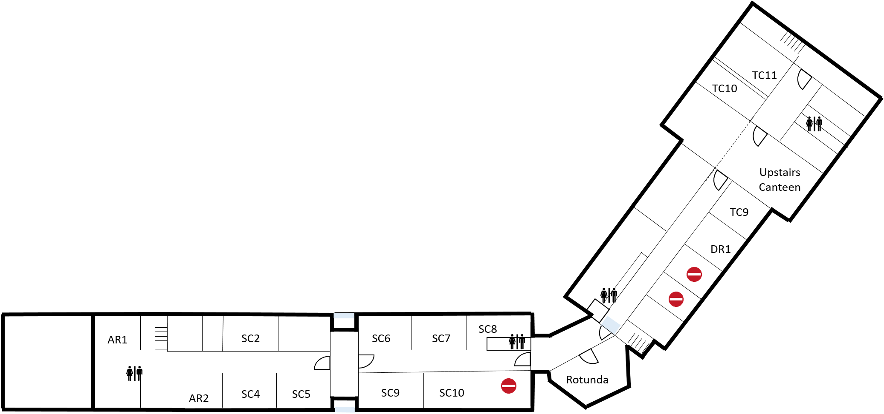
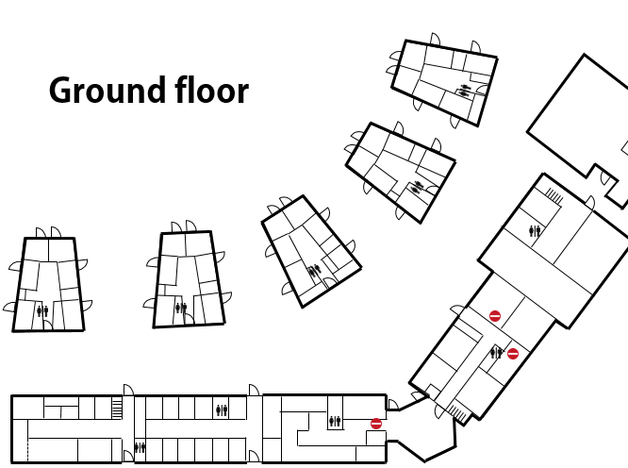
First floor
To end the tour click here

Slide 4
Art
Department staff
Miss S Spencer
Miss T Bellaby
Mrs K Hitchcock
Miss Santos
Interesting information
‘Building powerful knowledge to grow confident & creative global citizens.’
At Lincoln Academy we all value the importance of Art and Design. Our goal is to ensure you have a solid base of knowledge, skills and understanding in Art to enable you to problem solve and appreciate the creativity of others throughout your life. You should take pride in your work and look forward to engaging in creative practice.
The Art department is located upstairs in the main building, near Science.
What will I learn?
We look forward to meeting you all and hope you are looking forward to getting your teeth stuck into -
· hearing stories about some of the greatest and most influential Artists that ever lived and studying their work.
· mastering drawing and painting, using knowledge of the Formal Elements (Line, tone, pattern, colour and texture).
· developing creativity through learning new skills and finding out about the place and importance of Art in other Cultures.
Next Year you will start off by learning about the life and work of Van Gogh.
Do you know which constellation he shows in his famous painting Starry Night?
Cancer, the crab
The Big Dipper
Canis Major
Orion’s Belt

Slide 5
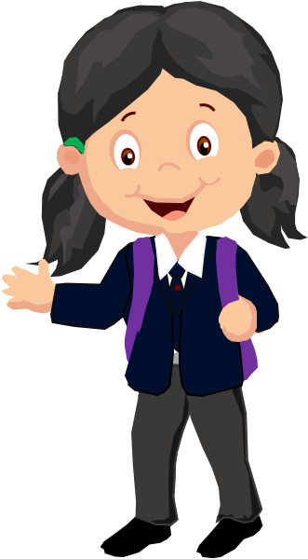
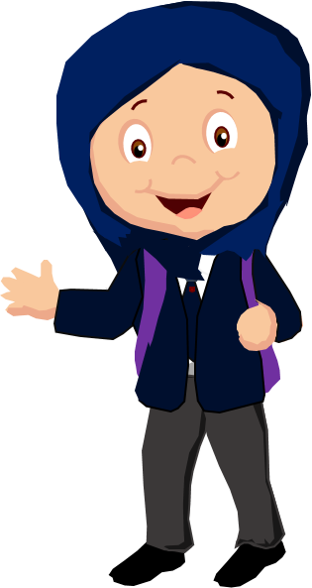
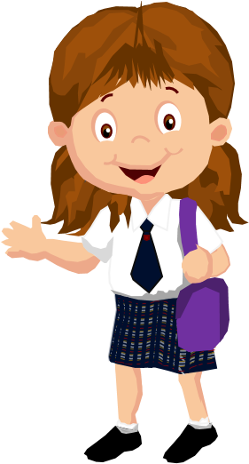
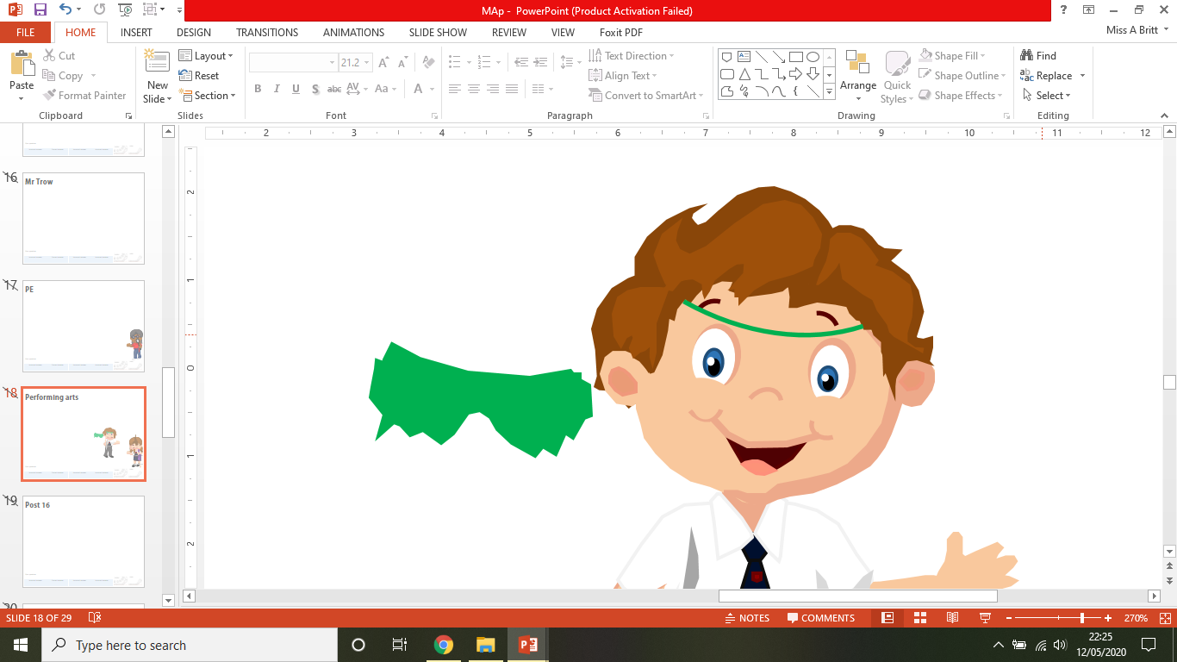
Break and Lunch time
Litter is a Health Hazard - It's not just that it looks awful. Cups full of rainwater make a perfect breeding ground for disease-carrying mosquitoes. Rats, insects and bacteria all love litter. It clogs storm drains and causes serious flooding.
Break and Lunch is about you enjoying some social time but also refuelling, using the facilities (toilet!), speaking to a member of staff outside of lessons and having some down time.
All staff have a duty point and there are also Sixth Form prefects that are treated as staff who help to keep everyone safe.
Litter Moves
It doesn't stay where it falls.
It gets trapped in fences, drains, and planted areas. It travels with wind, water, vehicles, people and animals. It affects communities, animals, tourism and the environment.
You are more than welcome to walk around, play football on the 3G at lunch or just sit and enjoy the weather but we thrive on looking after our environment so we celebrate #beingproud of ensuring litter is in the bin and we take care of each other.

Slide 6
Design Technology – DT/Engineering
Department staff
Mr G Joseph
Miss A Britt
Mr C Hoey
Mr G Burrell
Miss Santos
Interesting information
As well of having links with many of the other subject you will learn, Design Technology also helps us to become global citizens.
There are lots of opportunities to join enrichment activities, have a go at a variety of competitions and go on exciting visits.
Design Technology is taught in a rotation. You will spend time in Design Technology, Engineering, Food and IT.
What will I learn?
In Y7 in Technology you will learn a mixture of traditional and modern design and manufacturing techniques. You will make a train that will include using a CAM laser cutter, as well as traditional techniques like chiselling, and will incorporate a mechanism. You will learn how to read orthographic drawings and produce products from them. You will also make a colour changing lamp and a timber box. We will support you in producing 3D virtual models in an industry standard CAD package.
Which of the following would not be used for cutting metal?
Coping saw
Guillotine
Hack saw
Tenon saw

Slide 7
Design Technology – Food
Hello, I have a riddle for you.
My body is round, I am white inside. I often wear a red jacket. I am healthy and grow on trees. What am I?
Department staff
Ms R Brogden
Mrs K Hitchcock
Mrs H Miller
Mrs C Martin
Miss Santos
Interesting information
Did you know that there is more to Food than cooking? The knowledge you learn at school could help you to become a Food lawyer, Food stylist for advertisements, a health coach, farmer or restaurant manager.
What will I learn?
In Y7 Food Technology you will learn about food safety, food nutrition and produce healthy and nutritious meals. You will become competent in a range of cooking techniques, for example, selecting and preparing ingredients; using utensils and electrical equipment; cooking in different ways; using awareness of taste, texture and smell to decide how to season dishes and combine ingredients; adapting and using your own recipes. You will also be taught the source, seasonality and characteristics of a broad range of ingredients.
Something that can cause you harm is called…
A control system
A risk
A hazard
A symptom

Slide 8
English
Did you know…
The first book ever printed in the English language was The Recuyell of the Historyes of Troye by William Caxton in 1473?
That’s nearly 550 years ago!
Each year, nearly 2.2 million new books around the works are published!
Department staff
Mr Grummell
Mr Brown
Mrs Duggan
Mr Noon
Miss Black
Mrs Turner
Mr Ansty
Miss Terry
Miss Duggan
Mrs Brookman
Mrs Bainbridge
Miss Holloway
Miss Towning
Miss Parry
Miss Ridgway
What will I learn?
In English you will develop your wisdom by going on a fantastic journey through English literature, studying the best novels, poems and short stories ever written! From Ancient Greece to Victorian England; from Shakespeare to Shelley; and from Beowulf to Barnes, you will learn how English literature has changed over the centuries, and explore the themes of Power, Responsibility, Identity and Relationships.
Year 7
Unit 1- Greek myths and ‘Beowulf’
Unit 2-Romanticism
Unit 3-Shakespearian Comedies- focus on ‘A Midsummer Night’s Dream’
How many plays did William Shakespeare write?
27
37
47
57

Slide 9
Humanities– Geography
Fancy a fieldtrip?
In Geography there’s plenty of opportunities to get involved in fieldwork and become a subject champion. We take a trip to the Holderness Coast, do some local fieldwork in rivers and get to even hold some bizarre rainforest creatures when Zoolab visit us!
Department staff
Miss Hinch
Mr Galbraith
Mrs Thompson
Mrs Tindall
Interesting information
Throughout your time here you’ll develop your locational and map skills learning how to be an excellent Geographer! Have you ever wondered why some places get so many hurricanes or earthquakes yet others have none? Or how people can be best prepared for flooding? Geography is the place to be!
What will I learn?
When you arrive at Lincoln Academy you’ll take a journey through our planets oceans and learn how and why they are so important to people and our earth’s climate. You’ll explore how diverse and unique the environment is and how people have threatened these fragile environments and damaged them over time.
You’ll learn about how people live in very different ways to us and how we can best try to close the gap between the richest and poorest people within Africa and strangely why China wants to set up businesses there! After having learnt about Russia you’ll be able to decide whether you think the Geography of the largest country in the world is a benefit or a curse!
What percentage of the Earths population lives in the Northern Hemisphere?
60%
90%
70%
50%

Slide 10
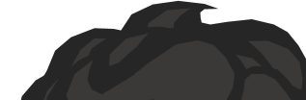
Humanities– History
Interesting information
Henry VIII introduced a tax on beards in the 16th century which depended on a man’s social status.
King Henry III had a polar bear at the Tower of London which went fishing in the river Thames.
One of the scientists who worked on developing the nuclear bomb won Nobel peace prize 50 years later.
In WWII British soldiers only got 3 sheets of toilet paper a day as part of their rations.
In History you’ll have the wonderful opportunity to take part in trips to the Lincoln Castle, Cathedral, Museums as well as The National Holocaust Centre. Should you chose the subject for GCSE we also run an overseas trip to Berlin!
Department staff
Mr Kent
Miss Diack
Miss McGregor
Mrs Tindall
What will I learn?
In History we’ll explore how people lived, what they believed and how they were ruled. We’ll delve into the significant events in Britain and the world from the Middle-Ages through to the Modern era. You’ll have the opportunity to explore the challenges and changes to Britain, Europe and the wider world through time. Here’s just a flavour of what you’ll learn about in this awesome subject in KS3.
Whether 1066 was a turning point?
What were the greatest threats to the crown in the Middle Ages?
Why was the transatlantic slave trade was abolished?
Why do historians still argue about the birth of the British Empire today?
You’ll journey through the Industrial Revolution looks at the quality of life for people through to the Victorian Empire.
‘Lions led by Donkeys.’ Is this a fair description of the British army during the First World War?
How did British women achieve equal voting rights to men in 1928?
Did the trial of Adolf Eichmann show that ‘normal’ people can commit war crimes?
How many female British monarchs have there been?
1
10
4
6

Slide 11
Humanities– World Views
In this subject we have a number of outside speakers join us for workshops with lots of opportunity to ask questions and learn about different views!
Department staff
Miss C Hinch
Mrs J Bayston
Miss E Johnson
Miss A Diack
Mrs I Thompson
Mrs J Tindall
Interesting information
The Bible is the most stolen book in the world.
Mary (Jesus mother) is mentioned more times in the Qur’an than the Bible. She is the only woman mentioned by name in the Qur’an for Muslims.
13% of Jews live in NYC making it the biggest group of Jews outside Israel.
The Buddha was made a saint in Christianity.
Hindus were the first people to use the number zero and the concepts of pi and infinity.
What will I learn?
Welcome to Worldviews! In this fascinating subject you’ll look at some of the puzzling questions that not only people often wonder about but those that people disagree about too! We’ll explore why people believe such different things, where their different beliefs come from and how religion has been the source of conflict across the world. We will delve into some of the following questions learning to debate, discuss and question different points of view as we go along.
How religious are people of the UK? Can people be spiritual but not religious?
Are Science and Religion competing?
How relevant is the Bible today?
Should the Pope ever be a woman? Why do some people think religion is sexist?
What do different people believe happens when we die? Why is this?
How do religious laws influence how people live?
How should I live if God is dead?
Which Hindu God has the head of an elephant?
Vishnu
Ganesh
Sita
Hanuman

Slide 12
IT
You will have the opportunity to start working towards the Inspiring Digital Enterprise Award – a scheme run by Buckingham Palace, which you can currently achieve Bronze and Silver levels.
Teachers
Mrs A Vernon
Miss A Britt
Mr A Smales
Interesting information
IT stands for Information Technology and encompasses learning related to Computer Science, Online Safety and understanding technology. You will have IT lessons in Year 7 as part of the DT rotations.
What will I learn?
In Year 7 IT lessons, you will learn how to use our school network, including using email, as well as further developing your understanding of using technology safely. You will learn more about IT systems, use different types of software and develop your understanding of programming, leading to learning how to write your own code using Python!
A list of rules to follow in order to solve a problem is called an…
Alligator
Algorithm
Allotment
Al got rhythm

Slide 13
Learning
Support
Everyone in Learning support is friendly, you might be seeing a theme there.
You might visit the Learning support area to work with staff from other organisations, or to work with Mrs Mckeown or to have help with various aspects of your learning.
Department staff
Miss Keenan
Mrs Chisholm
Miss Shepherd
Mrs TindalL
Miss Holloway
Miss Towning
Miss Parry
Miss Gudalytis
Miss Moody
Miss Santos
Miss Ridgway
Mrs Mckeown
Interesting information
There are 12 staff in Learning Support who work throughout all the departments in the academy to ensure you get the help you need to make progress in all the subject areas. They are called Progress Support Assistants or PSAs. They work alongside your classroom teacher to ensure you understand what is happening in the lesson. They can also act as mentors. A mentor is someone who can offer advice or support on matters that are often not related to your learning, for example, if you get lost or you forget your PE kit or your dinner money. They are very good at solving problems with you.
Our ethos is to prepare you for the challenges of the 21st century. We want you to make positive connections, to not be afraid to try something new, to have the courage to be active and involved in your surroundings, to be curious and take notice of the things around you, and to be generous and giving towards others.
Which people in the community do NOT wear uniforms?
Nurse
Teacher
Police Officer
Fire Fighter

Slide 14
The Library
Our library is a cosy room full of books and a great librarian.
Library staff
Mrs R Featherstone
In your own time, for your independent learning, we want to see you browse and borrow books, complete quizzes to check your understanding of the books you’ve read, and complete a Reading Passport, in which you will write reflections on different texts you have read in Year 7.
We can’t wait to meet you.
A message from Mrs Featherstone:
We want our students to become Ambitious, Successful, Polite, Independent, Resilient and Empowered because we believe these are the key qualities needed by young people in today's society.
School Librarians are often asked for reading lists and we have a fabulous Library page on our website which gives you a list of recommended titles.
The year 7 suggestions are easy to read and will prepare you for the books which are one step up as you enter your teenage years.
"A book is a dream that you hold in your hands "
I look forward to meeting you all in the Library.
Mrs Featherstone - Librarian
In what year was A Christmas Carol by Charles Dickens first published?
1438
1934
1843
1384

Slide 15
Maths
Welcome to the Maths department. Do you know what Pi is? The most decimal places of Pi memorised is 70,000. How many can you recall? Can you challenge the department staff?
Department staff
Mr Westgate
Mrs Greaves
Mrs Underwood
Mrs Hickin
Mr Smales
Mrs Urbaczka
Mr Perkins
Mrs Westgate
Miss Sutherland
Mrs Carrott
Mrs Moody
Mrs Gudalajtys
Interesting information
The mathematics department offers several enrichments such as finance club, homework support and several opportunities to enter into regional and national mathematics competitions
What will I learn?
In year 7 you will look at all 4 of the main areas of Mathematics, number, geometry, shape and space and statistics and data handling. In year 7 the main focus is on number skills however this branches off into lots of the wider areas of mathematics and makes links to other subjects including science and humanities. You will learn how to organise your thoughts in structured well thought out ways with an emphasis on showing how you have arrived at your answer
How many faces does a square based prism have?
6
5
4
1

Slide 16
French
Department staff
Miss F Bevan
Mrs K Jones
Mrs Davey
Miss Santos
Interesting information
At the Priory Lincoln Academy, we are dedicated to developing global citizens of the future. Students work hard learning new language and skills and enjoy the success of communicating in another language. You will have the opportunity to exchange letters with a student in Bayeux in France. There is French Club every week where you can practice your French through games, cooking, films and research. We are also hoping to run a trip to Paris and Euro Disney for you in Year 8.
Bonjour!
Welcome to French! The French Department is located in B Pod.
What will I learn?
In Year 7 you will develop knowledge and skills to communicate in French about yourself and the world around you, such as your family, your home, school, vocabulary for shopping, food and describing Lincoln! Having a good understanding of French helps you understand about how your own language is formed and this helps you in all your other school subjects!
How do you say ‘thank you’ in French?
Merci
Vielen Dank
Obrigando
Dziękuję

Slide 17
PE
The Priory Lincoln PE department are proud to have you join the Academy. From the very start you will experience fun and varied challenges through a variety of different experiences. Keep in touch with the department through our social media accounts: Twitter: @PrioryLincolnPE, Instagram: Priory_LincolnPE
Interesting information
The department are proud to provide a comprehensive extra-curricular programme. We work with the local community in providing a wide range of different activities. These include
Football, Rugby, Swimming, Personal Training, Kick Boxing, Netball, Badminton, Athletics, Rounders and Girls Climbing
The activities above are dependent on numbers and we are also welcome for new ideas!
The Academy is part of the Lincoln Gainsborough School Sport Zone and we compete in many different sports throughout the year.
Department staff
Mr Liu
Mr Chenh
Miss Gerrard
Miss Jorden
Miss Shutt
Miss Cannon​
Mrs Elsom
What will I learn?
In Year 7 you will explore the impact of physical exercise on the body and the basic parts of the anatomy and physiology. This learning will take place via Football, Swimming, Personal Survival, Touch, Health related exercise, Athletics, Rounders, Handball, Netball, Rugby/Touch Rugby.
How many running stitches does a cricket ball have?
3
6
8
10

Slide 18
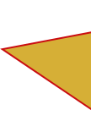
Performing arts
The Performance Department is so excited to meet you!
Are you a budding singer, aspiring actor, the next Kyle Hanagami? The Performance Department has something for everyone, from rock school to dance club, choir to bands and full blown plays and musicals.
Department staff
Mrs Jackson
Mrs Bramwell-Smith
Here’s a task you can have a go at
whilst you are waiting to join us in September.
Grab a plastic cup and try this - https://www.youtube.com/watch?v=Y5kYLOb6i5I
Find out more by following us on twitter @PrioryLincolnPF
Interesting information
We have two purpose built classrooms. One for Music and one for Drama.
MU1 can be found near the main hall. There is one large teaching room and two practise rooms. We have 13 keyboards, 3 drum kits, 16 computers with Sibelius, 2 electric pianos, acoustic and electric guitars and a vast collection of classroom percussion instruments.
The Drama Studio is located upstairs opposite the sixth form common room. It features a small performance stage and green screen wall, perfect for film and media projects.
We also have a fantastic team of Peripatetic Music teachers.
Mr Smith – Drum Kit
Mrs Calvert – Singing, Drama and Piano
Mr Copsey – Guitar (acoustic, electric and bass)
How many Keys are there on a modern Piano?
88
52
36
85

Slide 19
Post 16
Hi there!
You will see many 6th form students around the academy. If you need any help we are useful people to ask as many of us have been at the Lincoln Academy for 5 or 6 years.
There is a team of 6th form prefects that help at break and lunch, work of the school council, representing your views and each year you get to vote for your Head Girl and Head boy.
Department staff
Mr Pitts: Head of Post-16
Mrs Jones: Pastoral care
Mrs Mansford: Pastoral care
Interesting information
The sixth form rotunda is the base for students in the sixth form to do work outside of their lessons. Student in the sixth form study 3 subjects in more depth than in the lower school.
And in their timetable they get allocated lessons to study quietly so they can do that work.
Students are also allocated a few “free lessons” where they are allowed to socialise with their friends or even be off the Academy site.

Slide 20
Language for Learning lessons
Lead team
Mrs Bramwell-Smith
Miss Black
Mr Noon
Interesting information
Language for Learning is what you might have called ‘Literacy’ at primary school. We know that to be successful in all your subjects, being able to understand, speak, read and write the language of each subject is the key to doing well.
What will I learn?
Every lesson you have in each subject will include elements of Language for Learning (listening, speaking, reading, writing), but you will also have two lessons every two weeks in the library, in which your learning will specifically focus on developing great listening and speaking habits in response to a range of texts, including fiction, non-fiction and poetry. In your lessons, you will sit in small groups and practise your listening and speaking in response to discussion prompts or controversial statements guided by your teacher.
… are fantastic enrichments on offer at Lincoln Academy.
There
They’re
Their

Slide 21
Science
Department staff
Mr Quinn
Mr Dungate
Dr Pass
Mr Dobbs
Mr Chill
Mr Moss
Mr Knowles
Mrs Morgan
Miss Skelding
Mrs Davison
Mr Espin
Mrs Chisholm
Miss Shepherd
Interesting information
Welcome to Science the most fun subject there is. In year 7 you will study all three sciences; Biology, Chemistry and Physics. You will gain knowledge in all three areas to give you the wisdom and curiosity to carry out practical investigations. We hope through your learning you will have a passion for science and apply it to everything in the real world. We hope you have an awe and wonder for the subject and want to study it further and possibly have a career in the future.
We have a STEM club which happens once a week. This brings together, Science, Technology, Engineering and Maths into a fun club. We will carry out fun experiments and investigations to look at how the four areas come together in everyday life. After Christmas we prepare a project for the Lincolnshire Schools Competition at the Lincolnshire Show in June. We will attend both days of the show, presenting your project to the public and the judges and having time to look around the show as well. We have won the competition in the past!
What will I learn?
In science you will learn through the mastering knowledge of the key concepts (big ideas) which underpin science. The three sciences are broken down into topics and we will spend lesson time reading about the topic, discussing the key words and what they mean and modelling the key concepts. We will apply the knowledge to the real world and the investigate the concepts through practical’s and looking at the mathematics involved.
We have quizzes at the beginning of the lesson to recap previous work, we have checkpoint quizzes mid-topic to identify gaps in knowledge and at the end of a topic we have an assessment which comprises of multiple choice questions and written answers
Which of the following controls what enters and exits a cell (the building blocks that make up all living things)?
Cell Wall
Nucleus
Cytoplasm
Cell membrane

Slide 22




All students and staff at Lincoln Academy belong to one of the four houses. Each house has a Head of House and Pastoral Manager.
Can you find out what subjects the Head of Houses teach by reading about the subjects you will learn?
Click on the House logos to hear about each of the four houses.
The pastoral team are there to help you. They are a sustaining, guiding, reconciling and nurturing support for us all.

Slide 23
Welcome to Tennyson, Miss Gerrard is our Head of House and Mrs S Jones is our Pastoral manager.
They can be found in the front offices of C Pod and in between working with our lovely Tennyson students they can be found debating whose turn it is to make a cup of tea! Tennyson students and staff proudly wear a bright yellow badge on their blazers and we all take great pride in being the Best House in the Academy. We are the current Sports Day Champions, which fills Miss Gerrard with joy as she is also a (very competitive) PE teacher! We can’t wait to meet all of our new Tennyson students in September and introduce you to our wonderful Priory Lincoln Family. See you soon!
Welcome to St Hugh. You can identify us from the Red badge that you will wear on your blazer, and our friendly smiles too.
Our Head of House is Mr Moss, he has asked me to welcome you to St Hugh, and without sounding biased, the best House in the school!
We are a highly competitive House that can excel in Academic and Sporting competitions.
Your primary point of contact for any concerns is your From Tutor, but if you do need to talk to Mr Moss or Miss Ward don’t hesitate to pop down before school, after school, at break, or during lunch. Miss Ward is our fantastic pastoral manager. They can’t wait to see all of your lovely faces in September, until then stay safe.

Slide 24
Hello from Newton House! We are a welcoming house with some amazing Form Tutors, who work hard to ensure you make every moment at the academy a success! Miss Shutt our Head of house and Miss O’connor our Pastoral manager are there to help, guide and support you when you need it. Whether it's to do with work, friends, family or anything else. Our students are determined and resilient, we always try our best in all the house competitions if we win that's great, if we don't we will be better next time. Newton students are generous with their time and are proactive in completing their Baccalaureate booklets. We want a close and strong community that can help each other in times of need. We are a great team and every member plays their part in it success. We hope you enjoy your time here at Lincoln Academy.
If you are lucky enough to join Franklin house, you’ll be with us until you leave in year 11. We wear a Green coloured pin badge on our blazer lapel to show we belong to Franklin. Belonging to Franklin house is a way of bringing together different year groups and staff for a common purpose – to beat the other houses in the frequent and varied house events that are held all year. Miss Bellaby our Head of House and Mr Perkins our Pastoral Manager cannot wait to meet you all.

Slide 25
Vocational
Vocational subjects are those that link to a particular area of work.
Teachers
Mrs A Vernon - IT
Mr M Pitts – Business
Mr A Smales- IT
Miss D Cass – Health and Social Care
You will have IT lessons in Year 7 as part of the DT rotations. Have you found this on the map yet?
Interesting information
Located in the building furthest away from the main entrance, Eastgate Pod (E-Pod) is where you will find most of the vocational subjects.
IT stands for Information Technology and encompasses learning related to Computer Science, Online Safety and understanding technology.
Business includes learning about Enterprise and Marketing, but it is an option subject that you can choose to take in Key Stage 4. Likewise, Health & Social Care is also an option subject.
Because a lot of the learning in Eastgate Pod here links to knowledge and skills required in different workplaces, you’ll see a lot of the Academy Values reflected in the work we do to help students learn and prepare them for being citizens of the world, able to pursue careers and interests of their choosing.

Slide 26
Sorry, that is not the correct answer.
Why not try again?
It’s ok mistakes help me learn.

Slide 27
Well done.
How did you work that out?
How many of the other questions can you get correct?

Slide 28
Good bye for now.
We look forward to welcoming you to The Priory Lincoln Academy.
Please press your ‘Enter’ key to end your tour.

