Slide 1
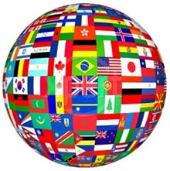
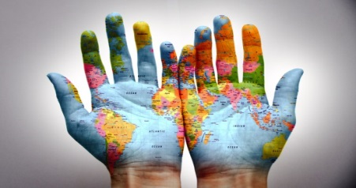
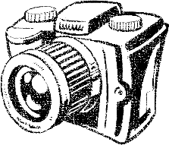
THE ART DEPARTMENT
Invites you to take part in our
HOUSE PHOTOGRAPHY COMPETITION
‘INTERNATIONAL EXCHANGE - Lebanon’
Entry is open to ALL staff and students. 6 photographs should be submitted that fit the theme
’My World’
Email sspencer@prioryacademies.co.uk for more information or to submit your entry.
Rules: You can only make one entry of 6 Photographs submitted in an attached word document. You must include your name, house, year group and form on the subject title. Only enter photographs you have taken yourself . Entries must be made by March 20th 2015.
Inspiration: Ideas for things you could photograph include buildings iconic to Lincoln, a scene from your house, objects relating to hobbies and interests or pictures from celebrations like birthdays or weddings.
Reward: Winning photographs will be sent to Lebanon as part of an International Exchange and displayed in our school. This is also a great opportunity to earn points for your house!
PLEASE SURPRISE US WITH YOUR CREATIVITY!

Slide 2
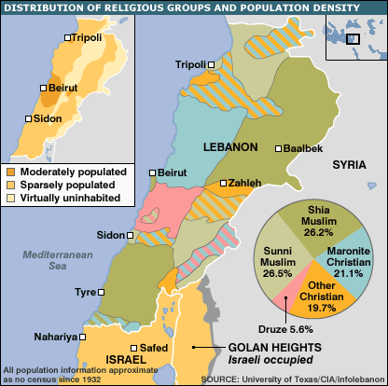
Facts about Lebanon from the bbc news website
Lebanon, a small, mountainous country at the eastern end of the Mediterranean, is home to 3.6 million people.
The most densely populated areas are around the capital, Beirut, and other towns.
Significant areas are sparsely inhabited.

Slide 3
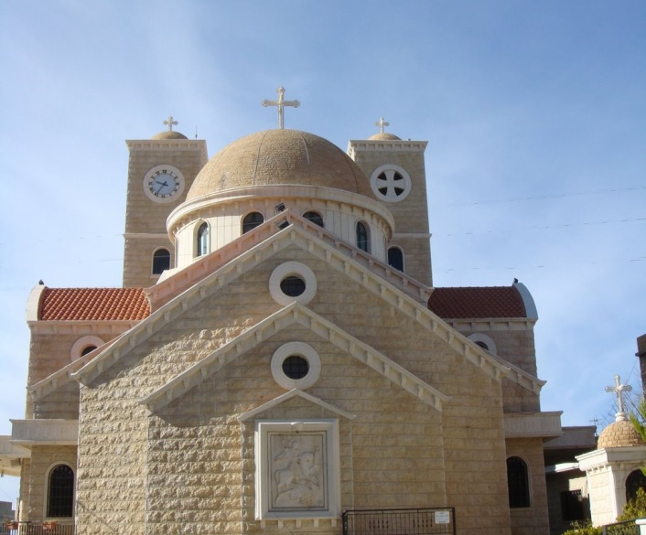

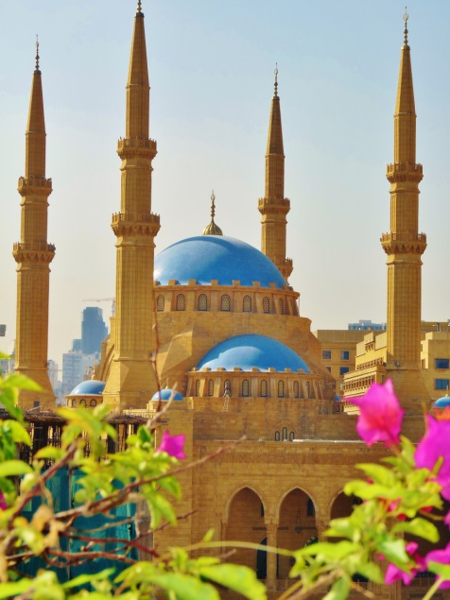

The country's diverse population consists of many religious and ethnic groups. Most people are Muslim or Christian, but exact numbers are not known as there has been no census since 1932.
While some regions see a particular group form the majority, others - including the area close to the Israeli border - are fairly mixed.
More than 400,000 Palestinian refugees live in Lebanon.

Slide 4
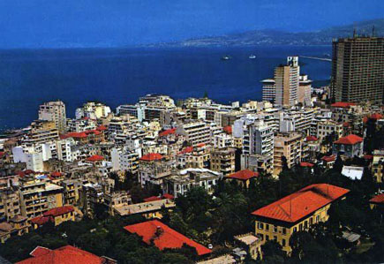
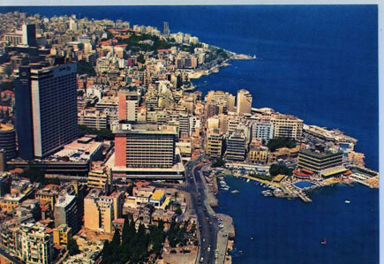
Until the civil war broke out in 1975, Beirut was one of the world's most fashionable cities and Lebanon a Middle Eastern banking hub. The pictures above were taken before the 1975 civil war!
Years of fighting destroyed much of the economic and physical infrastructure. But the country has since worked to rebuild its economy and, despite massive debts, remains a commercial centre.

Slide 5
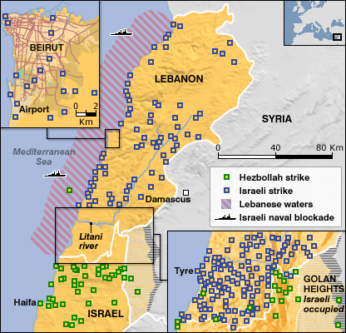
The fighting between Hezbollah and Israel in summer 2006 brought widespread destruction to Lebanon.
The capture of two Israeli soldiers by Hezbollah on 12 July triggered a devastating response from Israel.
Attacks by air, land and sea targeted Lebanese cities, roads and infrastructure, killing about 1,100 civilians and forcing up to 900,000 from their homes.
Hezbollah responded with rocket attacks on northern Israel, killing at least 43 civilians.
A UN-brokered ceasefire came into force on 14 August 2006 with Israeli troops still in position in south Lebanon.

Slide 6
Top tips for taking Great photographs

Slide 7
Explore composition
Consider ….
The rule of thirds
Framing (Fill the frame, organisation in the frame and cropping)
The rule of even and odd
The rule of triangles
Symmetry
Balance
Overlapping
Use of space (contemplative or movement?)
Unusual angles and viewpoints

Slide 8
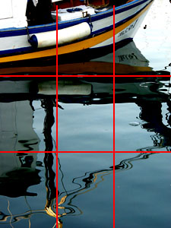
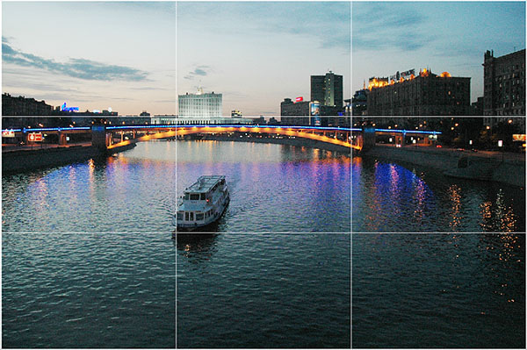
Rule of Thirds
Based on the fact that the human eye is naturally drawn to a point about two-thirds up a page.
Crop your photo so that the main subjects are located around one of the intersection points rather than in the center of the image:

Slide 9
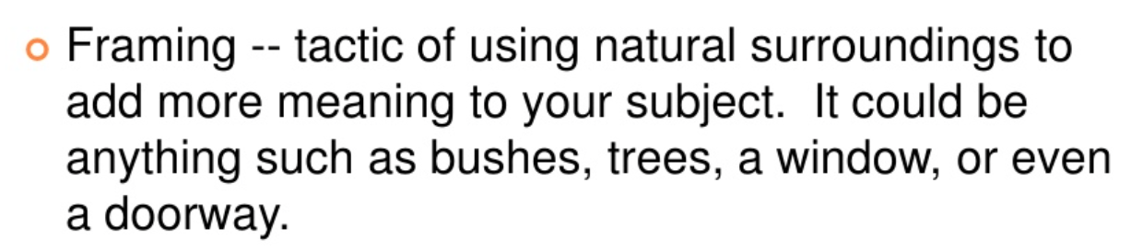
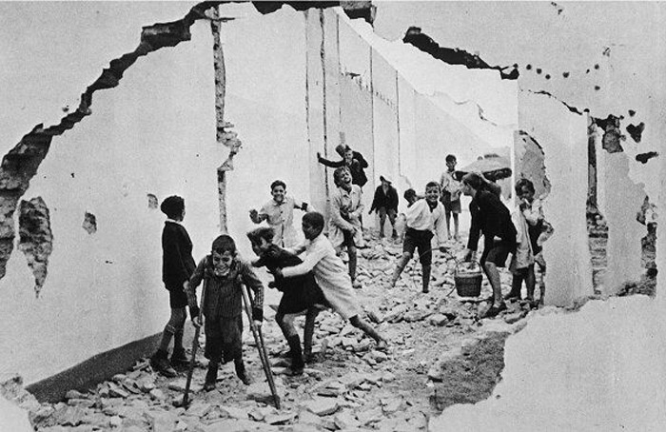
Notes:
The world is full of objects which make perfect natural frames, such as trees, archways and holes. By placing these around the edge of the composition you help to isolate the main subject from the outside world. The result is a more focused image which draws your eye naturally to the main point of interest

Slide 10
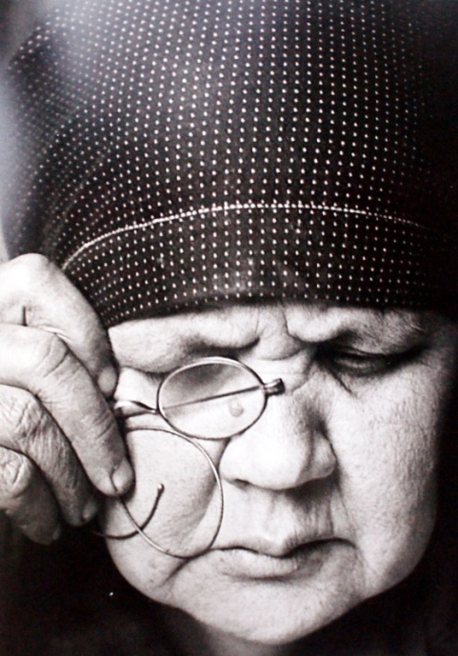
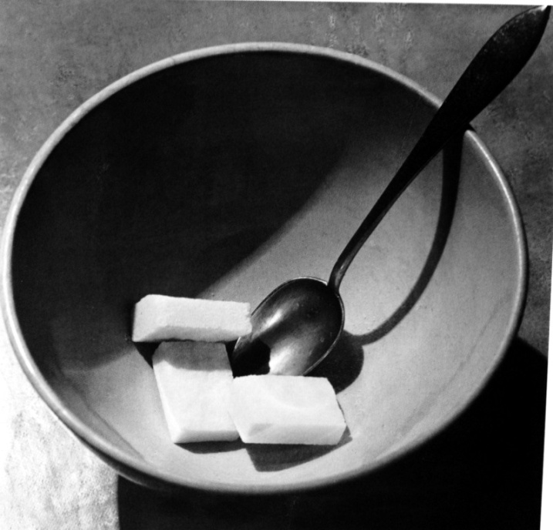
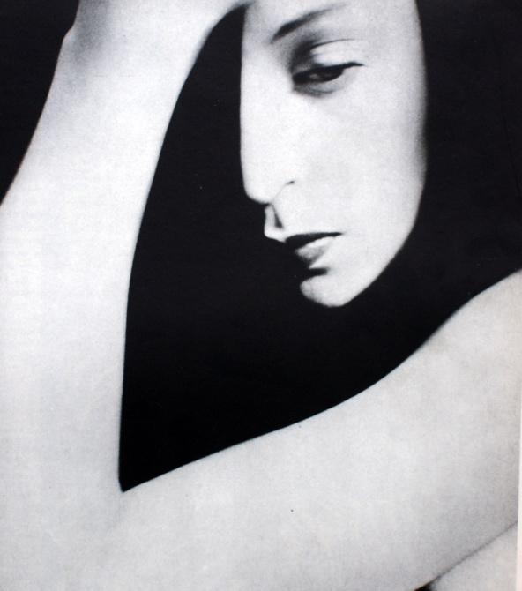
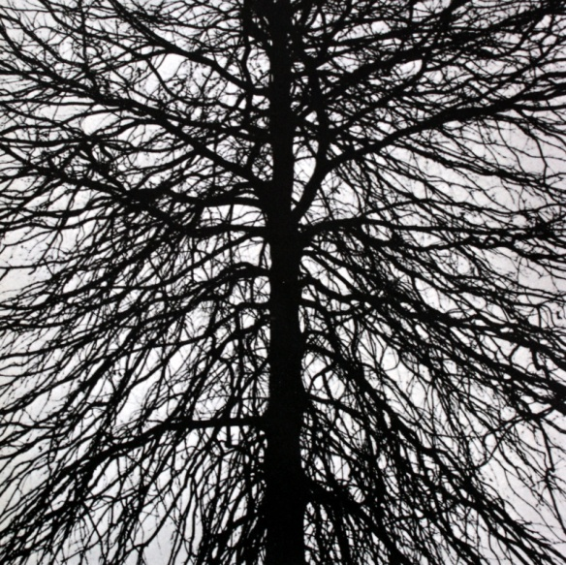
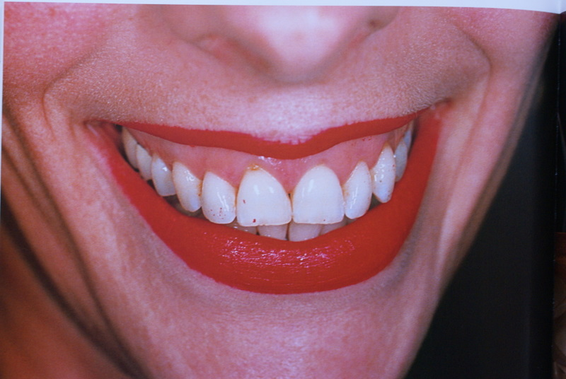
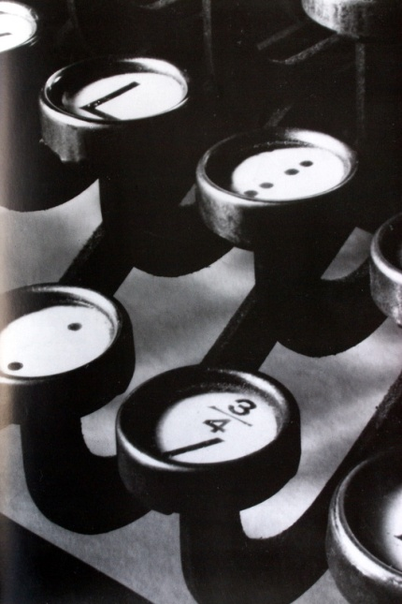
COMPOSITION. Practical approaches. ‘Fill the Frame’
A Rodchenko’The Artist’s Mother 1924
A Kertesz ’Bowl with Sugar Cubes 1824
Bill Brandt’Woman’1924
G Tice’Tree,New Jersey’ 1924
Martin Parr ‘From the series ‘Common Sense’1995
Ralph Steiner’Typewriter’ 1921

Slide 11
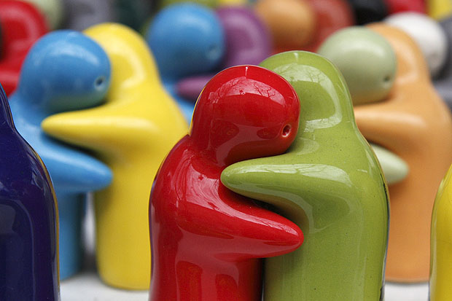
Cropping
Often a photo will lack impact because the main subject is so small it becomes lost among the clutter of its surroundings. By cropping tight around the subject you eliminate the background "noise", ensuring the subject gets the viewer's undivided attention.

Slide 12
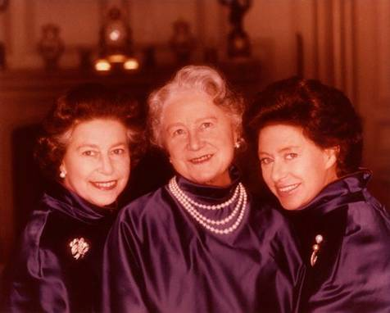
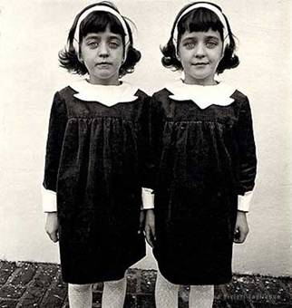
The Rule Of Even and Odd
An even number of ‘things’ in an image can sometimes create a feeling of tension or a slightly un-natural look.
Norman Parkinson
… while an odd number of ‘things’ can often create a feeling of harmony or balance
Dianne Arbus

Slide 13
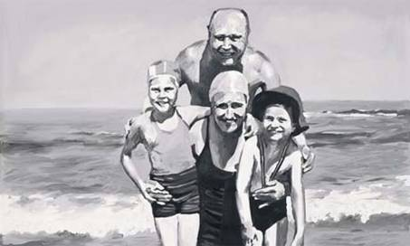
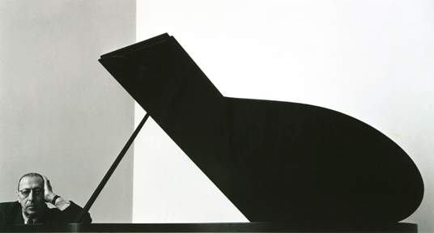
Rule of Triangles
Triangles have 3 sides and tend to form stable, solid looking compositions.

Slide 14
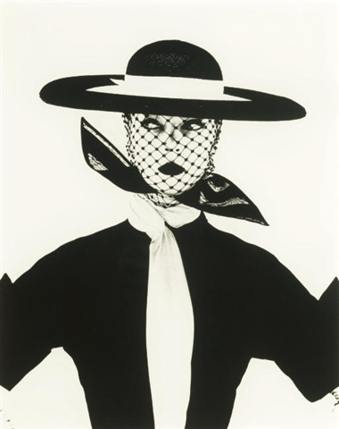
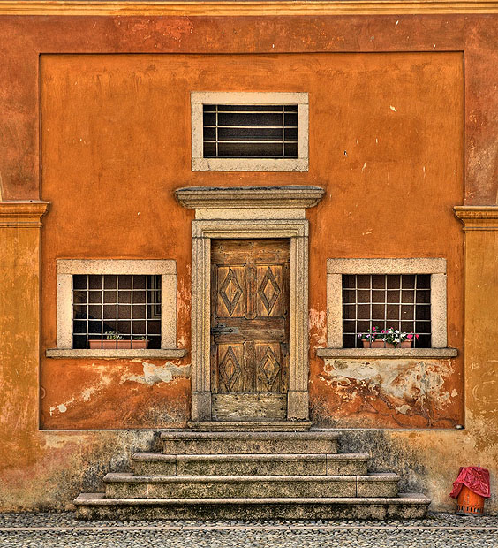
Rule of Symmetry

Slide 15
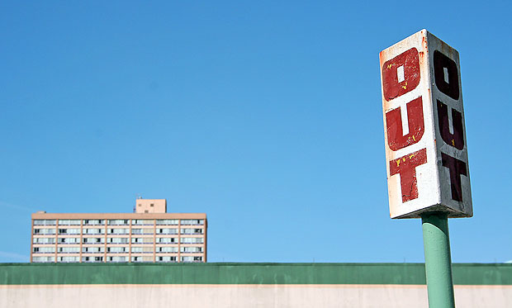
Balancing
Elements
Notes:
Placing your main subject off-centre, as with the rule of thirds, creates a more interesting image, but it can leave a void in the scene which can make it feel empty. You should balance the "weight" of your subject by including another object of lesser importance to fill the space

Slide 16
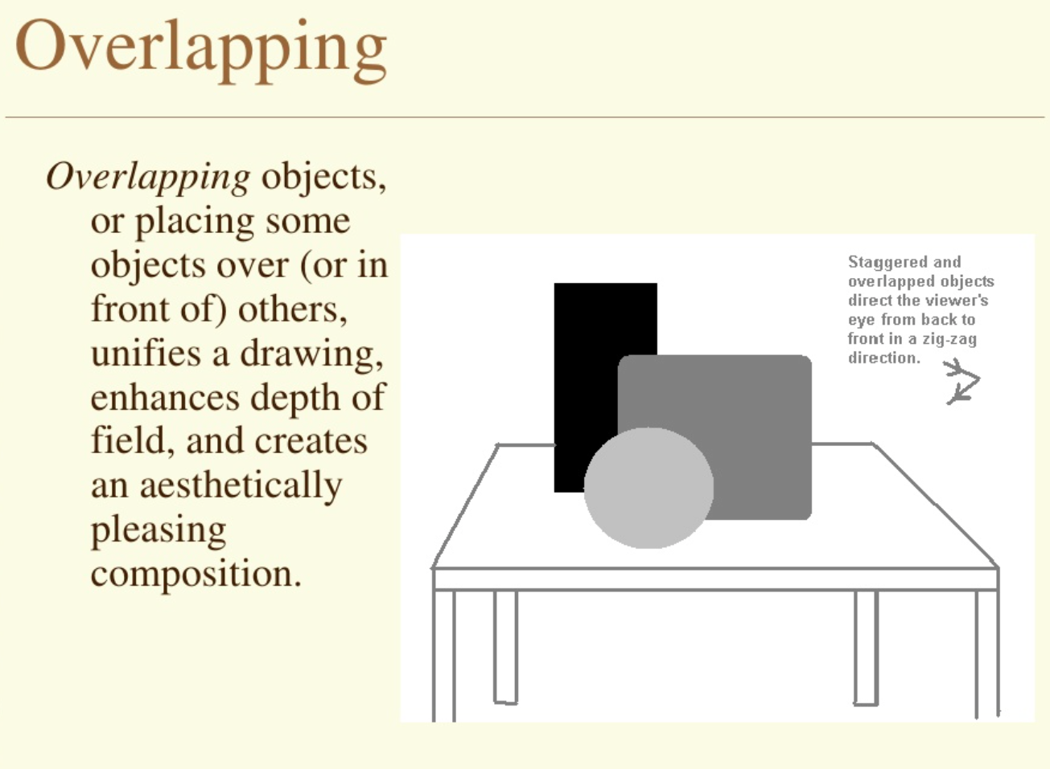

Slide 17
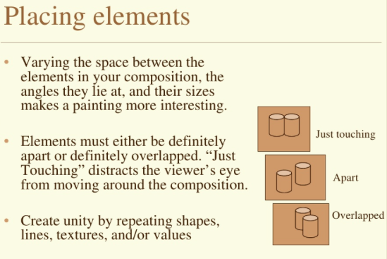
Overlapping?

Slide 18
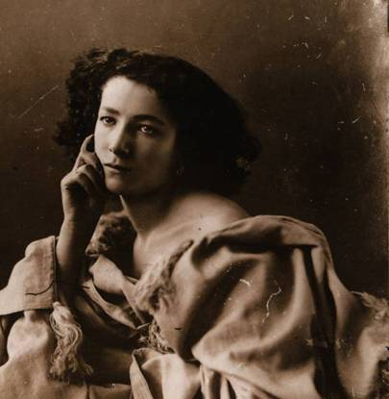
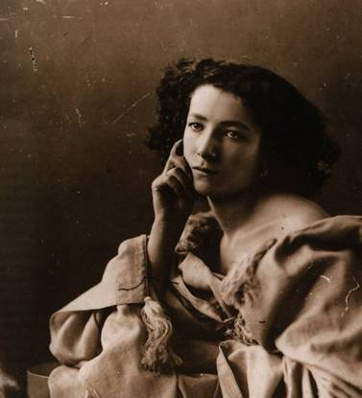
Rule of space
Nadar
The empty space in the right-hand image creates a more contemplative or thoughtful feel to it.

Slide 19
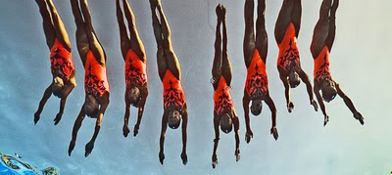
Space can also help create an impression of movement
In this image there is not much unfilled space
Swimmers diving into the water

Slide 20
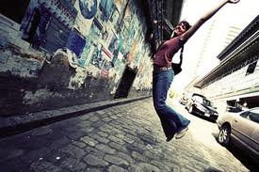
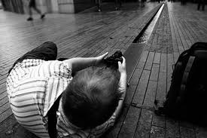
Unusual Angles and Viewpoints
What angles will you use to take your shot and how will you experiment?

Slide 21
Take photographs that People wanting to find out about our culture will find interesting
Ideas for things you could photograph include buildings iconic to Lincoln, a scene from your house, objects relating to hobbies and interests or pictures from celebrations like birthdays or weddings.

Slide 22
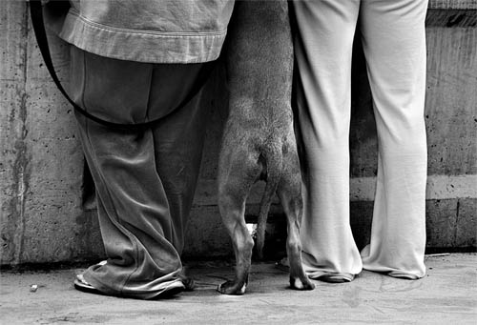

Slide 23
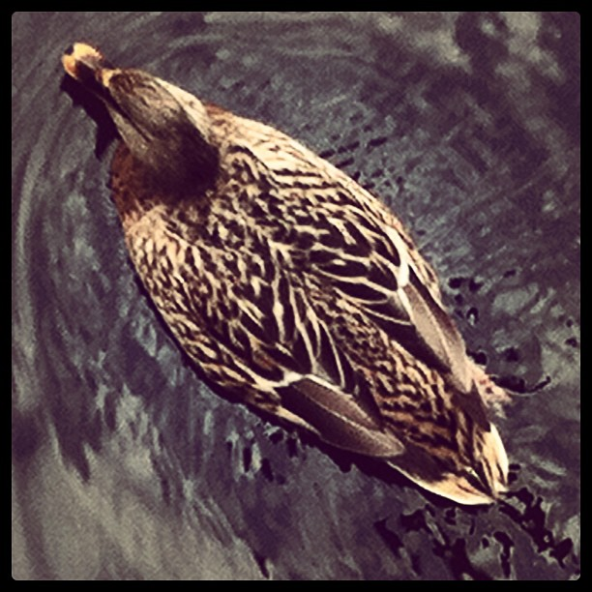

Slide 24
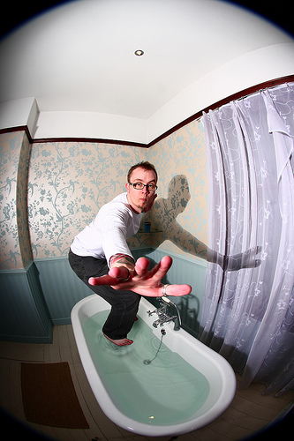

Slide 25
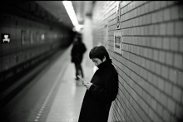

Slide 26
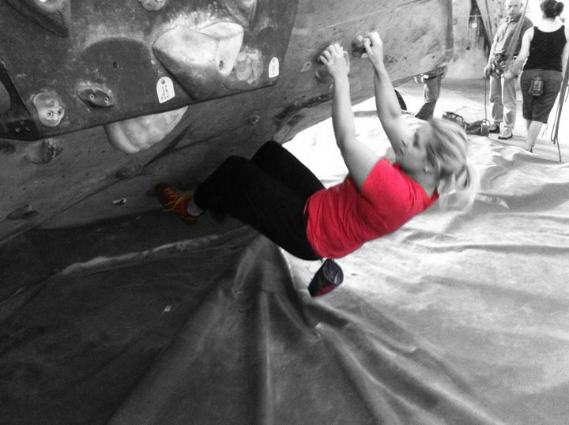

Slide 27
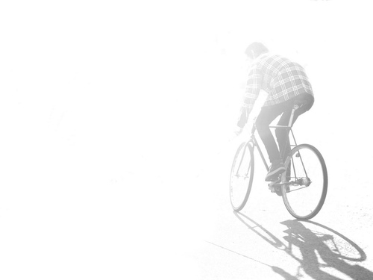

Slide 28
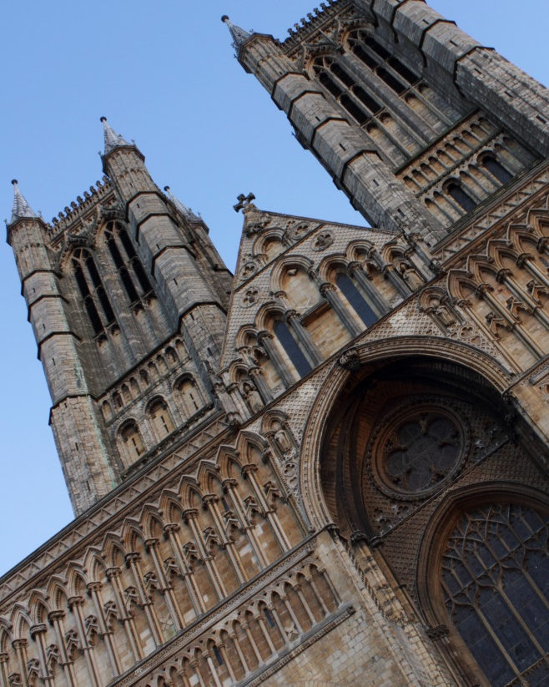
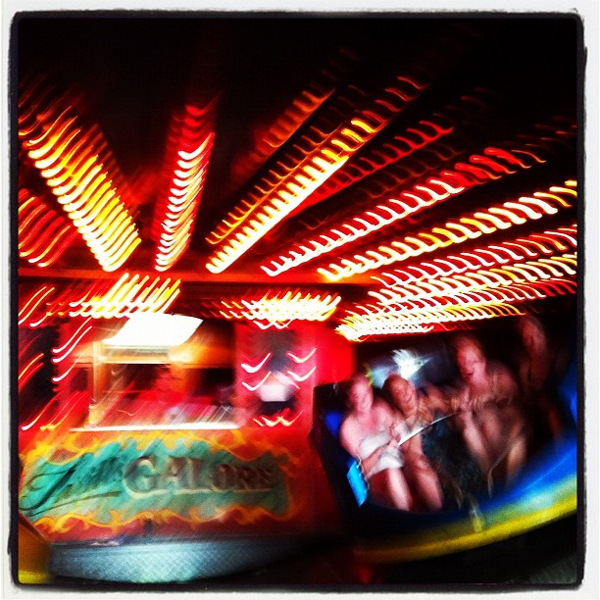
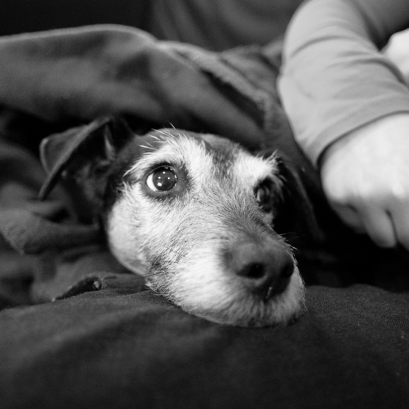
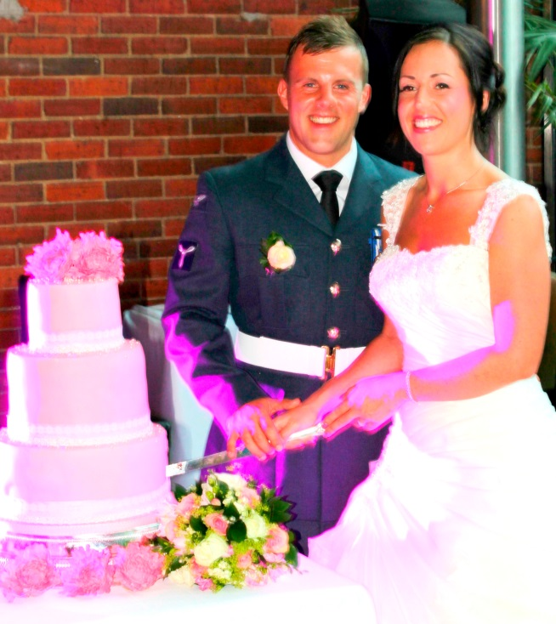
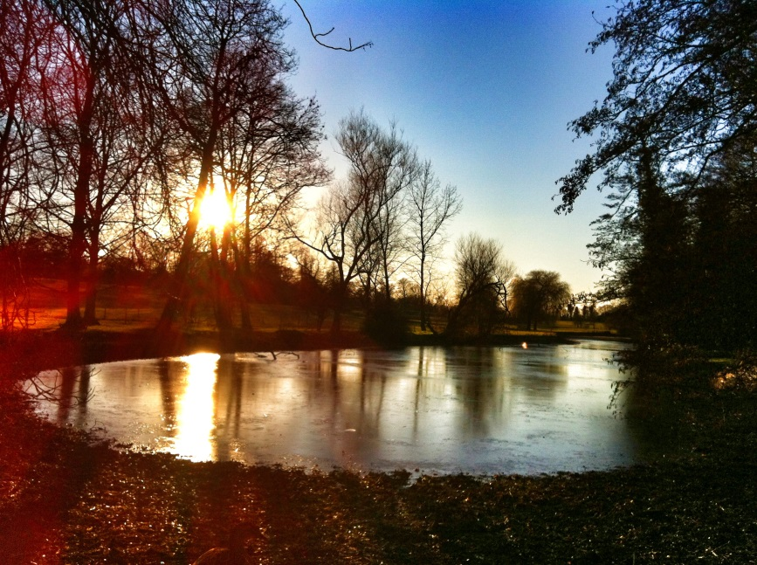
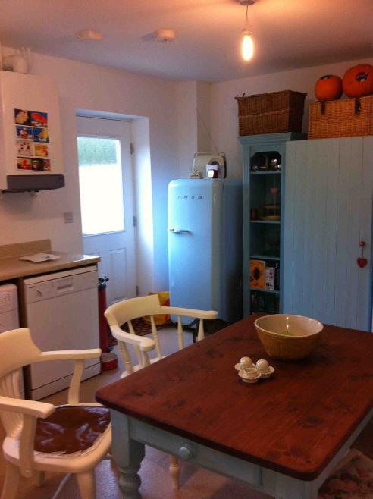
My 6 Photographs

Slide 29
Remember that not every photograph has to be “beautiful”
Emotions such as sadness, fear,
hope, nostalgia, anger and fragility
can also be beautiful, but in different
and often more powerful ways.

Slide 30
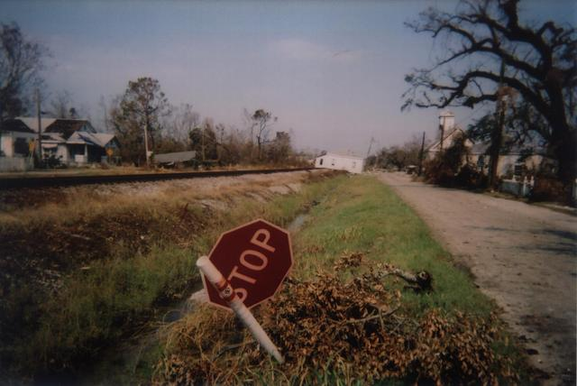

Slide 31
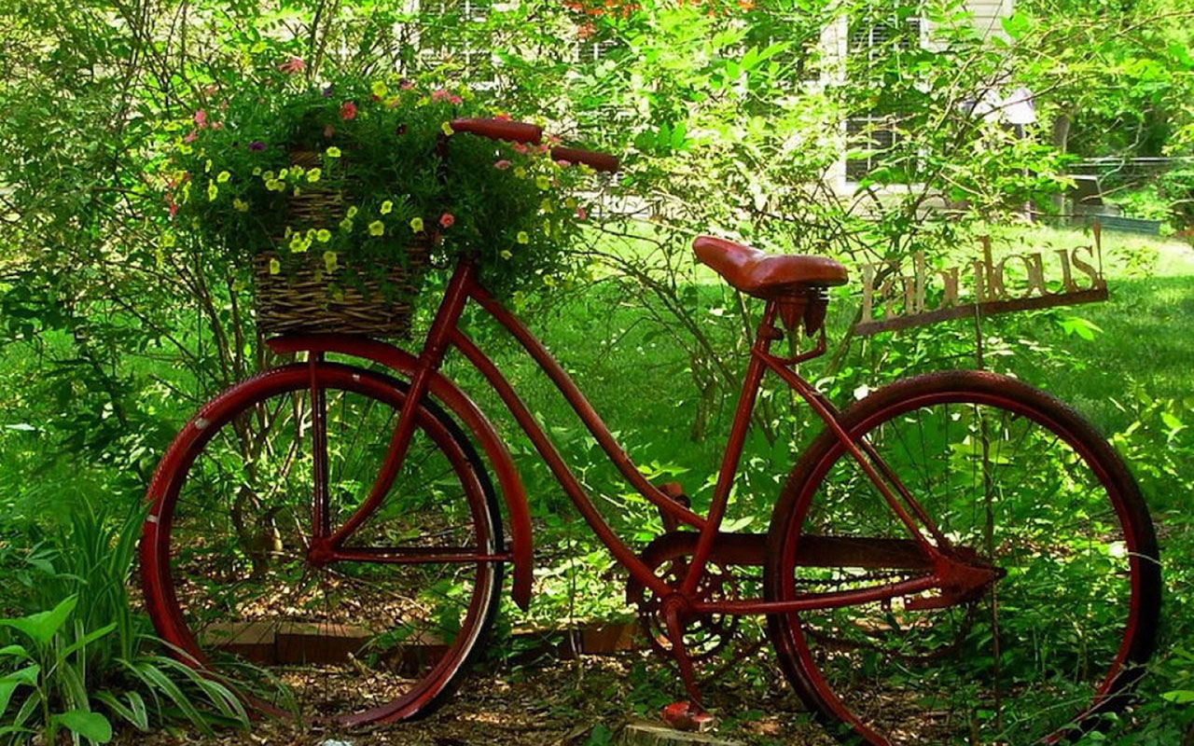

Slide 32
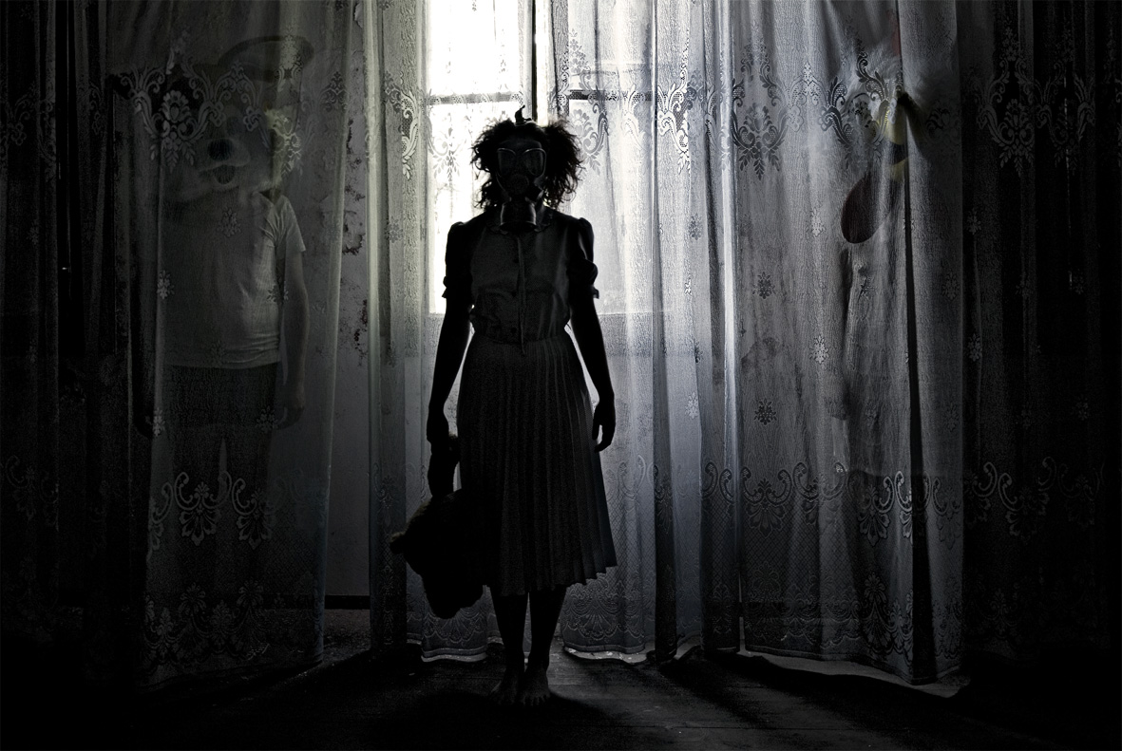

Slide 33
Plan your shoots
Props, lighting, subject matter,
location…

Slide 34
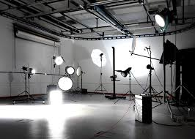

Slide 35


Slide 36
Experiment with focal point, depth, texture, colour, angle, reflections and perspective.

Slide 37


Slide 38


Slide 39


Slide 40


Slide 41


Slide 42
Edit your Photographs
There are many photo-editing programmes and software available. The best known is Photoshop. However, there are many free and user friendly programmes available. For example Picmonkey, Befunky or Fotoflexer.
Try basics such as cropping, under or over exposing, saturating or de-saturating colour.

